Slide 1
Unit 4: Measuring Keyness Statistics for Linguistics with R – a SIGIL course
Prof. Dr. Stephanie Evert
Computational Corpus Linguistics
FAU Erlangen-Nürnberg
https://www.stephanie-evert.de/ | @schtepf

Slide 2
What are Donald Trump's favourite words?
Trump tweets
(target)
other tweets (reference)
crooked
p = 340 pmw TTA: f = 453
p = 6.4 pmw
https://www.thetrumparchive.com/
everyone
p = 404 pmw TTA: f = 538
p = 404 pmw
keywords “occur with unusual frequency in a given text” or text collection (Scott 1997: 236)
basis: frequency comparison with reference corpus
Notes:
crooked
TTA: f = 453, p = 340pmw
English Tweets 08/2017: f = 1365, p = 6.4pmw
everyone
TTA: f = 538, p = 404 pmw
English Tweets 08/2017: f = 85677, p = 404 pmw

Slide 3
Keywords in corpus linguistics
Aboutness of a text ➞ key keywords (Scott 1997)
Technical/genre terminology (Paquot & Bestgen 2009)
Literary style (Culpeper 2009)
Linguistic & cultural differences (Oakes & Farrow 2006)
Historical perspectives (Fidler & Cvrcek 2015)
Similarity of text collections (Rayson & Garside 2000)
Corpus-based discourse analysis (Baker 2006)
also know as corpus-assisted discourse studies (CADS)
clusters of keywords represent central topics, actors, metaphors, and framings (e.g. McEnery et al. 2015)

Slide 4
Keyness
More generally, keyness is one of the most fundamental concepts in corpus linguistics
Frequency comparison between corpora A and B (representative of underlying linguistic populations)
For different kinds of lexico-grammatical items
word forms, lemmas, n-grams, multiword expressions
morphemes, grammatical constructions, n-grams of tags
Wide range of applications depending on choice of lexico-grammatical items and of corpora A and B

Slide 5
Applications of keyness
Bibliographic keywords
A = text, B = collection ➞ aboutness of text
also: key keywords (that are key in many texts)
Target corpus vs. reference
A = domain, B = general language ➞ terminology
items = n-grams / MWE ➞ multiword terms (SkE)
A = thematic corpus, B = reference ➞ discourse (CADS)

Slide 6
Applications of keyness
Symmetric keyword analysis
A, B similar but “opposite” ➞ contrastive framings (e.g. liberal vs. conservative newspaper)
Collocation identification
A = contexts of node word, B = rest of corpus ➞ collocations of node word
Corpus comparison
A, B = comparable corpora, items = grammatical constructions ➞ language variation

Slide 7
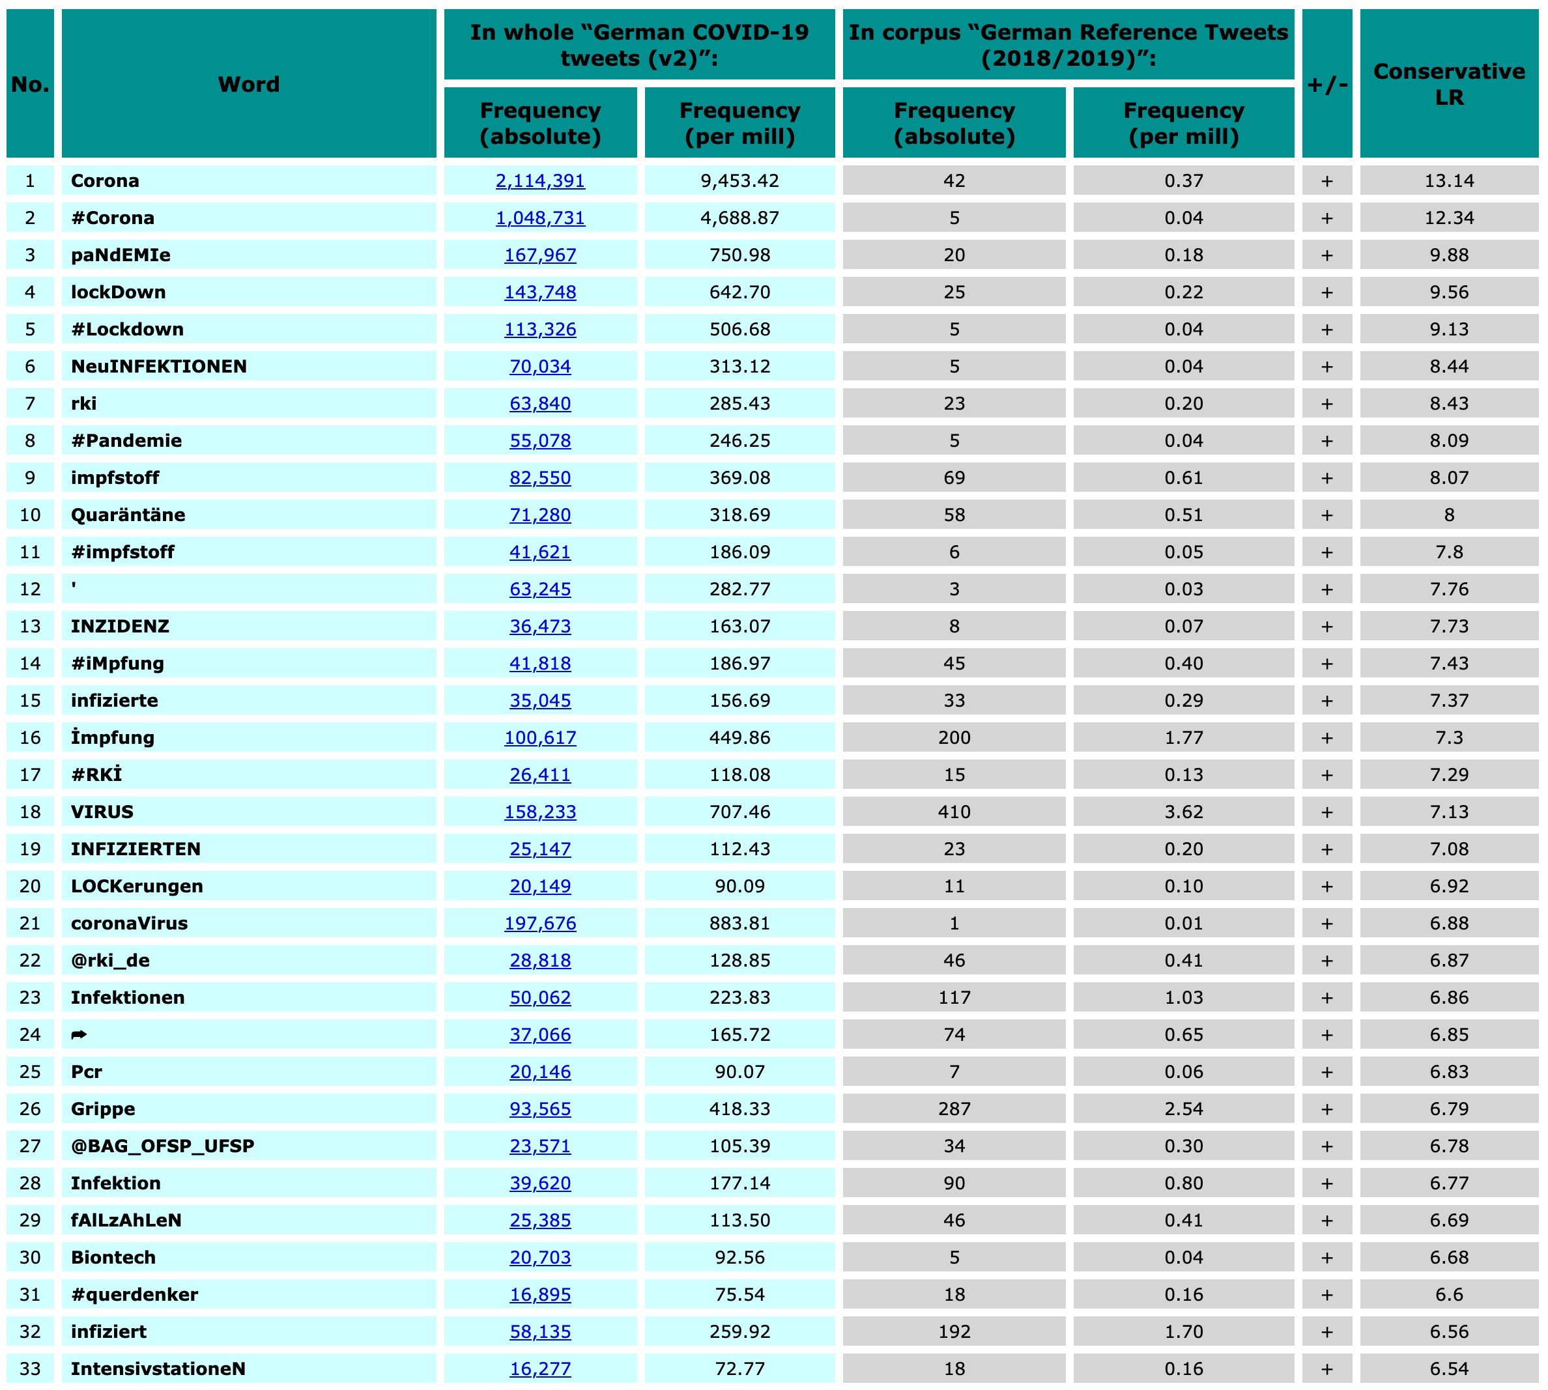

Keywords in CQPweb

Slide 8
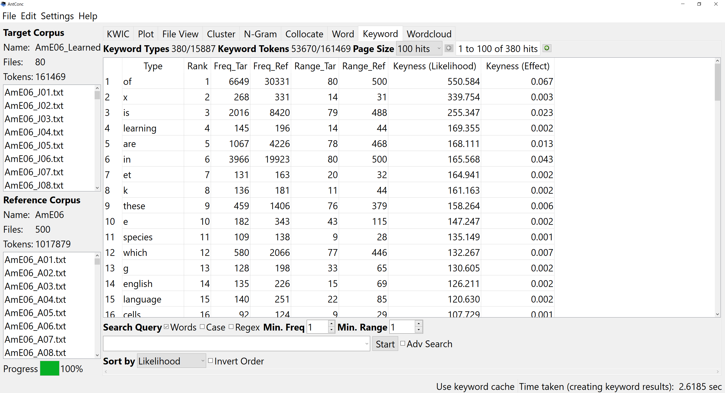
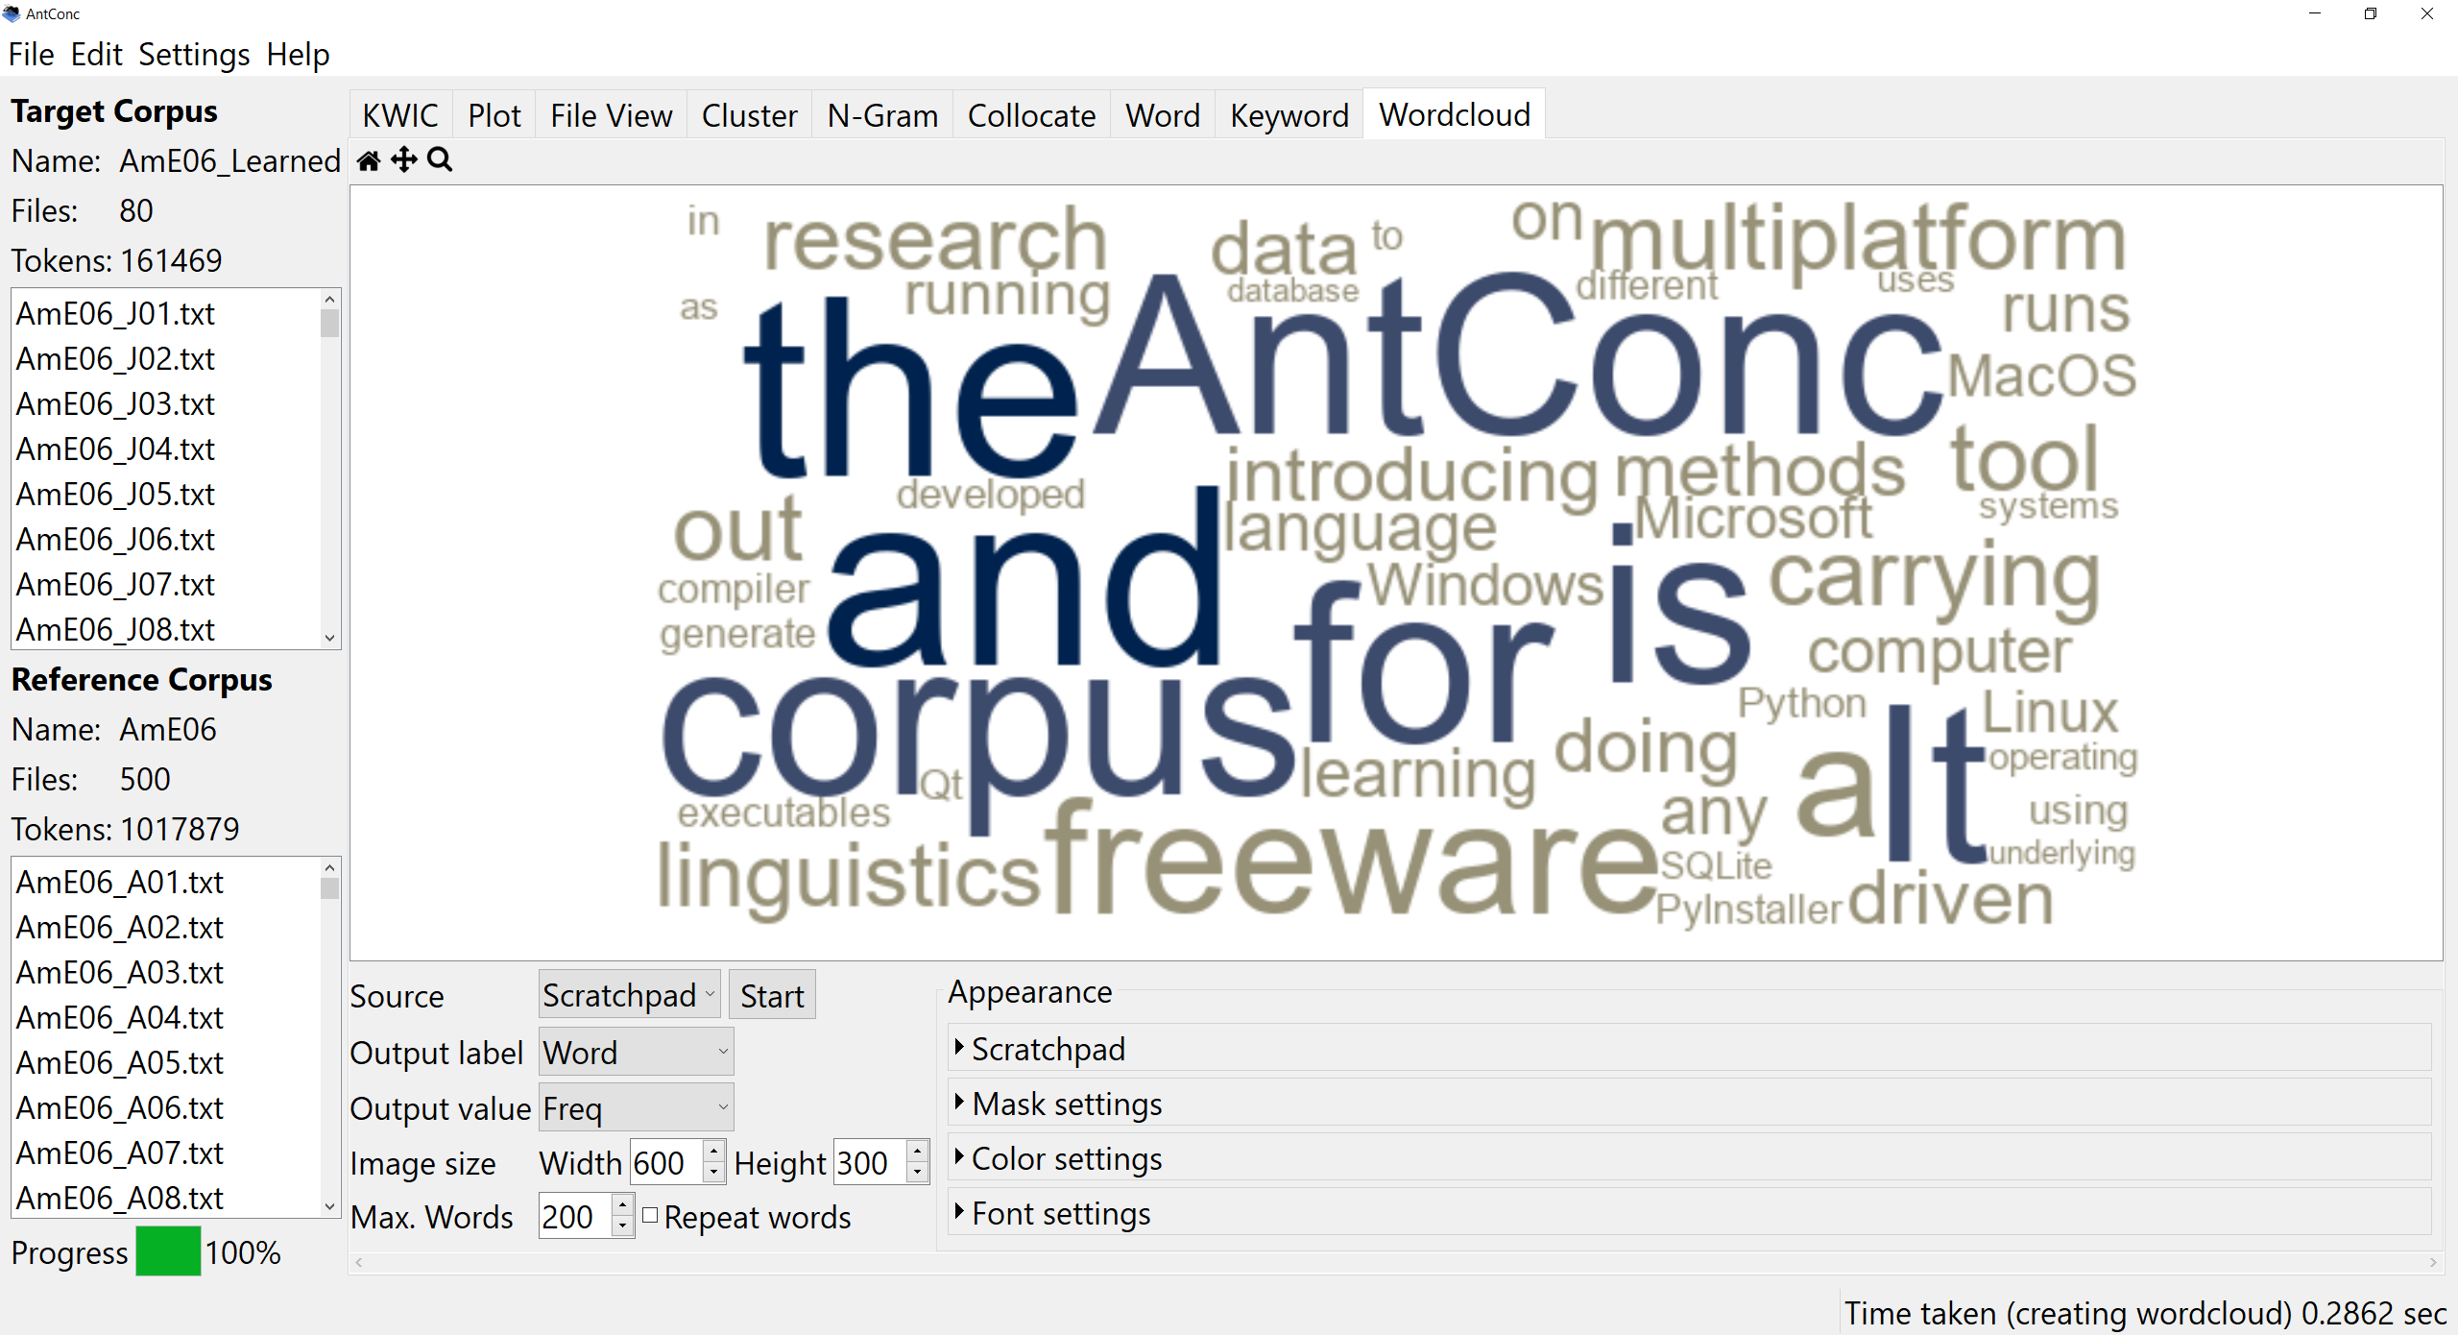

Keywords in AntConc

Slide 9
INSIDE THE BLACK BOX
But what is happening behind the scenes when you use such software?

Slide 10
Measuring keyness
Compare frequency in A with frequency in B separately for each candidate term w ∈ C
Frequency data for w
f₁ = freq. in corpus A
n₁ = sample size of A
f₂ = freq. in corpus B
n₂ = sample size of B
A
B
f₁ | f₂
n₁ – f₁ | n₂ – f₂
w
¬ w
= n₁
= n₂

Slide 11
Measuring keyness
Recent studies: document frequency more robust than term frequency (e.g. Egbert & Biber 2019)
Frequency data for w
f₁ = df in corpus A
n₁ = no. of texts in A
f₂ = df in corpus B
n₂ = no. of texts in B
A
B
f₁ | f₂
n₁ – f₁ | n₂ – f₂
w
¬ w
= n₁
= n₂

Slide 12
Measuring keyness
Goal: compare frequencies π₁ and π₂ of candidate item in sublanguages represented by corpora A and B
statisticians speak of “populations”
Best sample estimates (MLE)
positive keyword if π₁ >> π₂
negative keyword if π₁ << π₂
A
B
f₁ | f₂
n₁ – f₁ | n₂ – f₂
w
¬ w
= n₁
= n₂

Slide 13
Keyness measures: significance
Inference about frequency in population A vs. B
Observed contingency table
Contingency table of expected frequencies

Slide 14
Keyness measures: significance
Statistical hypothesis tests for H₀ in contingency table:
log-likelihood G² (Rayson & Garside 2000)
chi-squared test X² (Scott 1997)
Fisher's exact test (Lafon 1980)
data set from
Evert et al. (2018)
Problem: mainly focused on amount of evidence against H₀ ➞ biased towards high f₁
Notes:
top-250 keywords based on a data set from a study that we'll get back to later on
notice logarithmic scale of horizontal axis so it can capture the wide frequency range from f1 = 2 to f1 > 1000

Slide 15
Keyness measures: effect size
Focus on magnitude of difference between π₁ and π₂:
LogRatio (Hardie 2014) = log relative risk r
a better version (Walter 1975)
closely related measures: %DIFF (Gabrielatos & Marchi 2012), RRF, odds ratio, ΔP
Problem: ignores sampling variation ➞ often biased towards very low f₁

Slide 16
Keyness measures: significance filter
Effect-size measures combined with significance filter: set score = 0 if not significant according to G²
Hardie (2014): control family-wise error rate (FWER) in data set by using adjusted significance level
Heuristic alternative: frequency threshold
typically f₁ ≥ 5, 10, 100, …
often also requirement f₂ > 0 in reference corpus

Slide 17
Keyness measures: heuristics
Another heuristic: SimpleMaths (Kilgarriff 2009)
Mathematician: no comment!
Many other (often heuristic) association measures have been suggested for collocation extraction (e.g. Pecina 2005)
Hardie (2014) includes AM in his list of keyness measures

Slide 18
My measure: LRC (Evert 2022)
Combine effect-size and significance aspects: confidence interval [log₂ r–, log₂ r₊] for relative risk
Conservative estimate LRC (conservative LogRatio)
use value closest to 0 (not significant if 0 in interval ➞ LRC = 0)
n₁ = n₂ = 1M
f₁ = 30 | f₂ = 98 LogRatio = –1.7
f₁ = 7 | f₂ = 2 LogRatio = 1.58
LRC = –1.1
LRC = 0
–2
–1
0
1
2
log₂ r
Notes:
f1=7 | f2=2 → LR = 1.585 (Hardie: 1.81) → 95% confint = –0.586 … 5.110
f2=30 | f2=98 → LR = -1.691 (Hardie: –1.708) → 95% confint = –2.349 … –1.105

Slide 19
The maths behind LRC
Be careful with approximations such as the one used by CQPweb
Exact inference for relative risk in contingency table with conditional Poisson test (Fay 2010: 55)
Two-sided confidence interval
with Bonferroni correction
LRC = 0 if not significant
LRC > 0 ➞ significant pos. KW
LRC < 0 ➞ significant neg. KW
A
B
f₁ | f₂
n₁ – f₁ | n₂ – f₂
w
¬ w
= n₁
= n₂

Slide 20
Comparison
Based on candidate data from Evert et al. (2018)
Top-250 keywords from each measure

Slide 21
Evaluation
How well does it work in practice?

Slide 22
Evaluating keywords
Key challenge: many different applications of keyness ➞ different requirements and evaluation goals
Evaluation always wrt. a specific goal (e.g. CADS)
What to evaluate? – measures, reference corpora, …
Primarily manual validation of KW candidates
occasionally evaluation against gold standard possible (e.g. for identification of domain terminology)
special case: keyness measures for corpus comparison (Rayson & Garside 2000) can be evaluated with known similiarity corpora (Kilgarriff & Rose 1998)

Slide 23
Evaluation: a case study
14.3M token corpus on German web data about multi-resistant pathogens (MRO) collected with BootCat (Baroni & Bernardini 2004)
9,750 texts of varying genres and lengths
Target corpus: 1.3M tokens (1,177 texts) of mass media texts and reader comments from MRO corpus
Evaluation of different keyword extraction techniques for CADS analysis of MRO discourses (Evert et al. 2018)

Slide 24
Evaluation: a case study
Three keyness measures: G², LogRatio, LRC
Two comparable reference corpora: Süddeutsche (SZ) vs. Frankfurter Allgemeine (FAZ)
Keywords based on raw frequency (classic) vs. document frequency (df-based)
Extract top-200 keywords for each technique
frequency threshold f ≥ 5 in reference corpus, because we are not interested in terminology extraction
Manual annotation of TPs (categories, evaluative)
pre-determined category scheme from qualitative study
Notes:
Years 2011–2014 of Süddeutsche Zeitung (SZ), a left-leaning daily newspaper (290M tokens)
Years 2011–2014 of Frankfurter Allgemeine Zeitung (FAZ), a right-leaning daily newspaper (150M tokens)
All corpora: POS-tagged with TreeTagger and lemmatised with SMOR (Schmid et al. 2004)

Slide 25
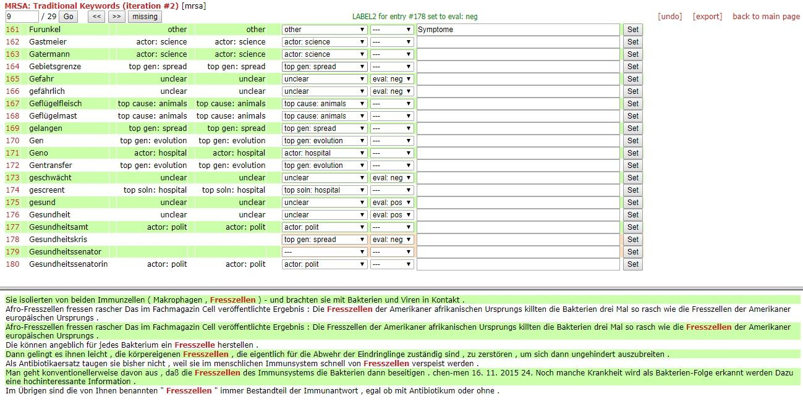
Annotation procedure
Web-based annotation platform MiniMarker

Slide 26
Agreement
Two independent annotators
Agreement of 82.2% on distinction TP vs. FP (but Cohen κ = .566 fairly low)
Domain-specific, highly frequent words often marked “unclear” (FP) by one annotator and TP by the other
Disagreements between TP categories less frequent; mostly due to overlap between discourse levels
metaphors as part of topoi
intertwined argumentational levels
Final gold standard jointly reconciled by annotators

Slide 27
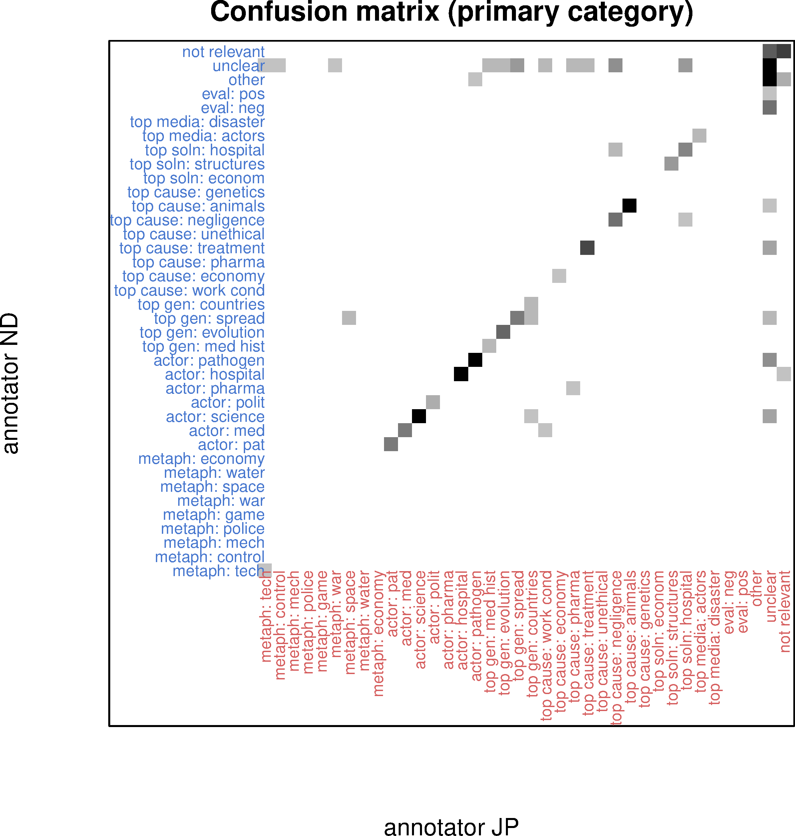
Agreement

Slide 28
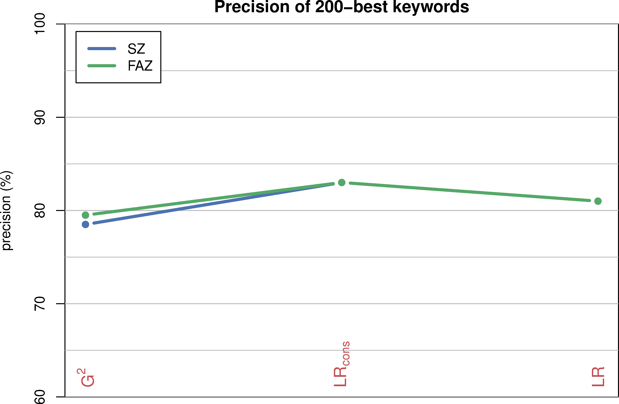
Precision = #TP / 200 candidates
TP = assigned to category and/or evaluative

Slide 29
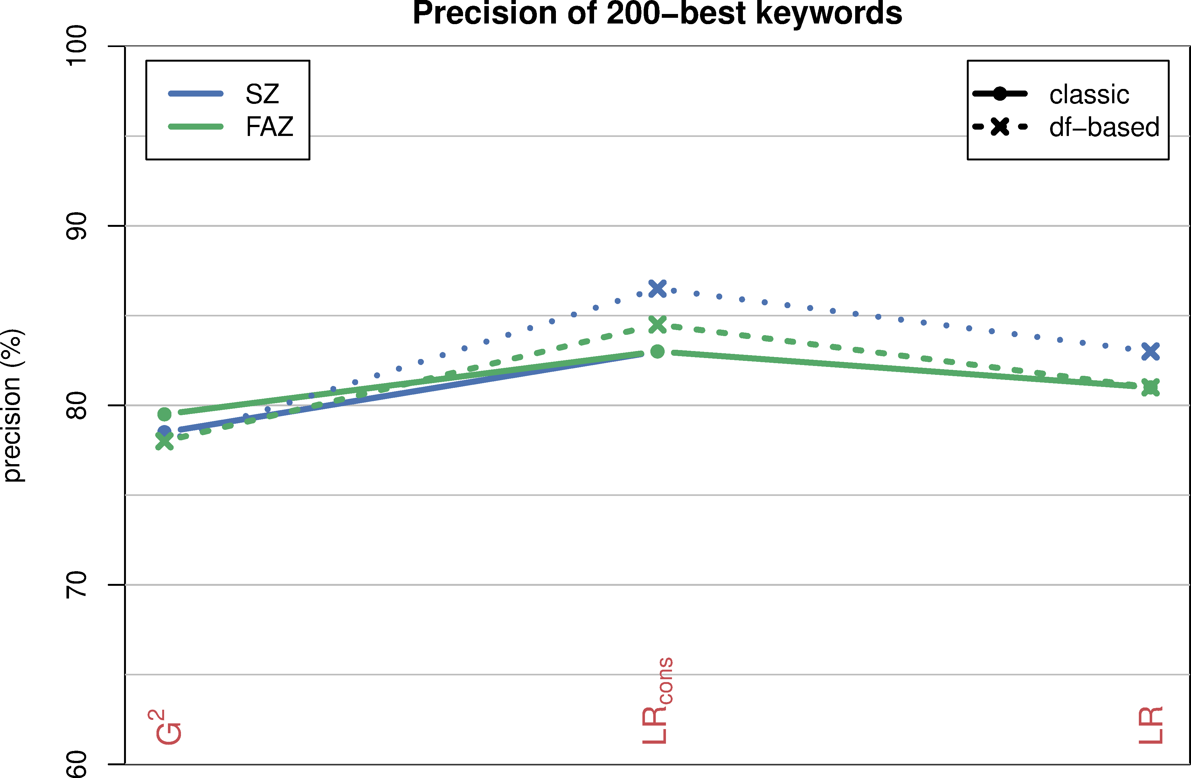
Precision = #TP / 200 candidates
TP = assigned to category and/or evaluative
*

Slide 30
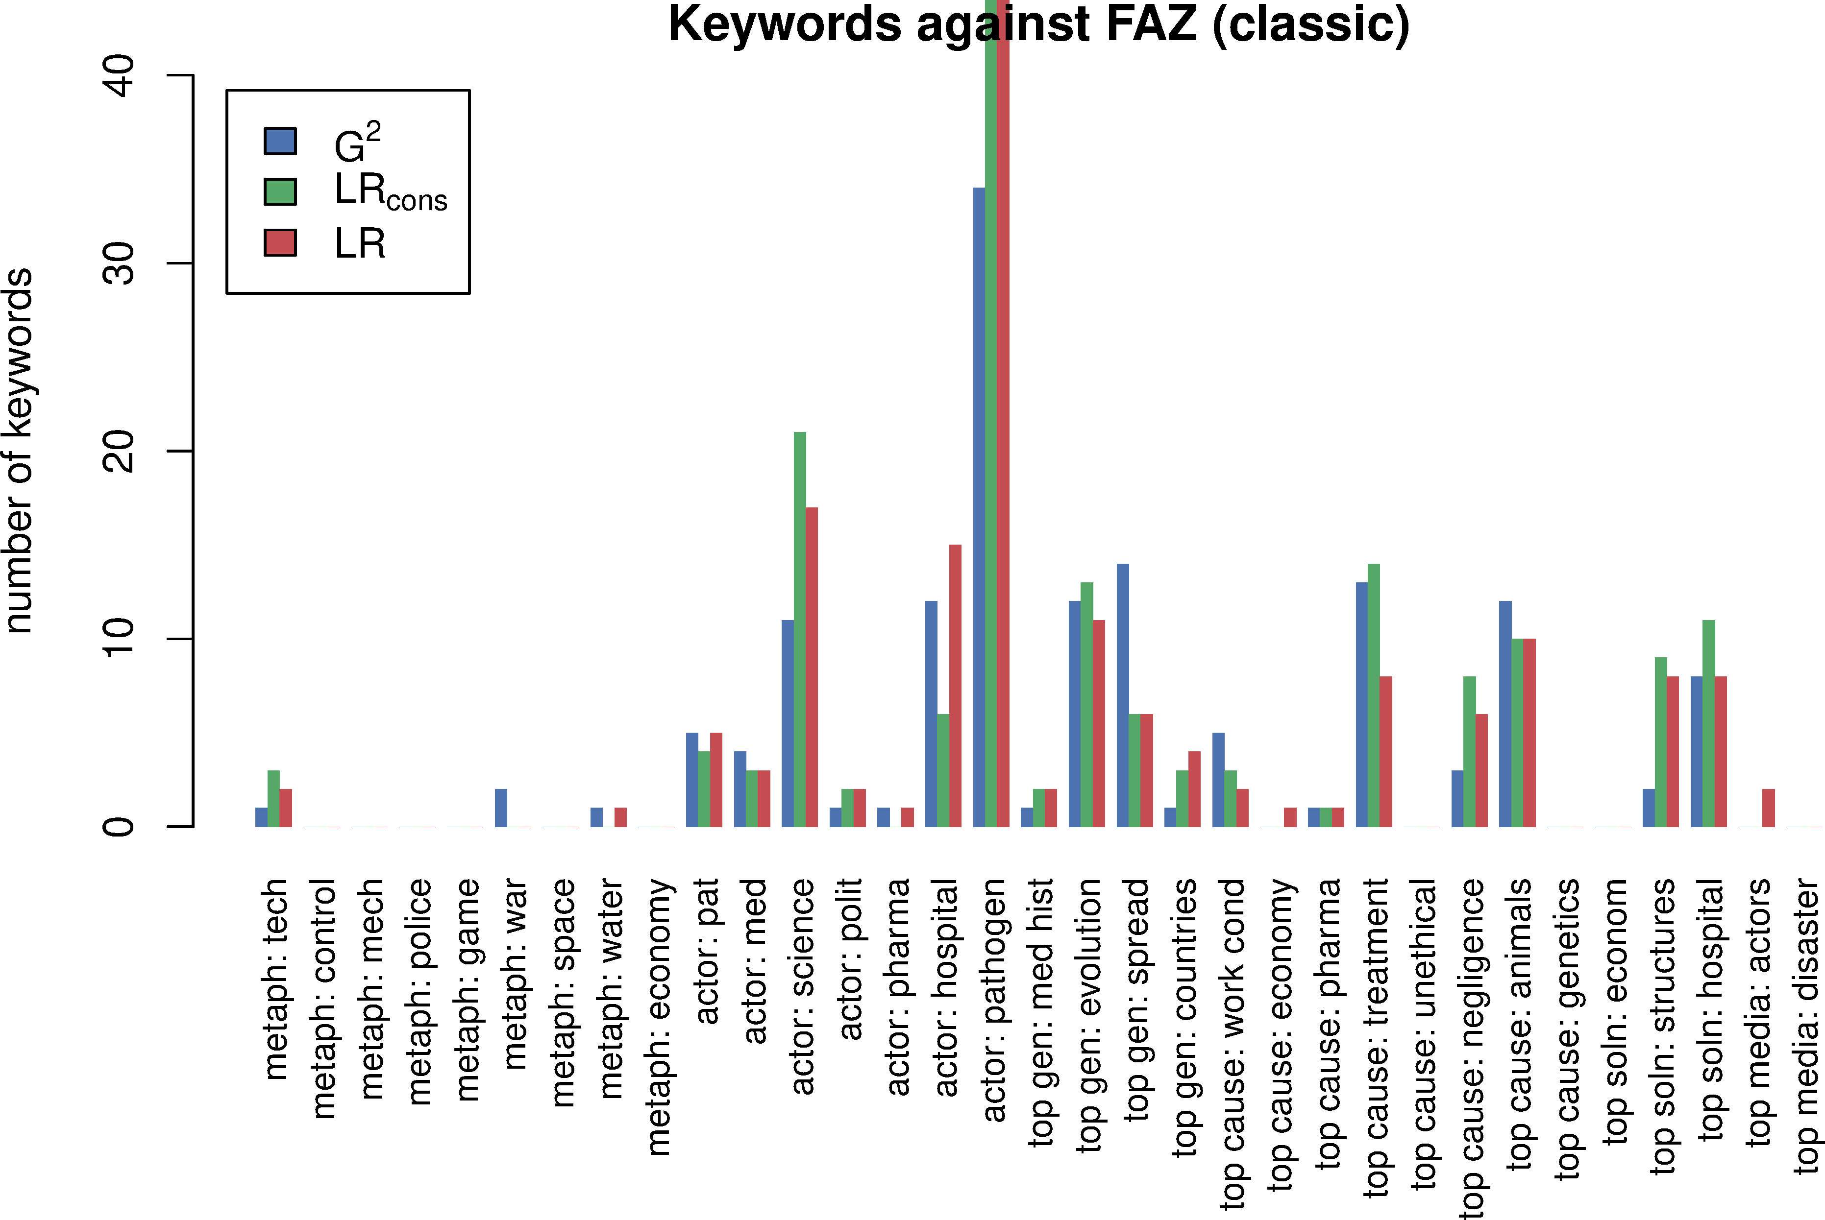
Recall = #KW for each category

Slide 31
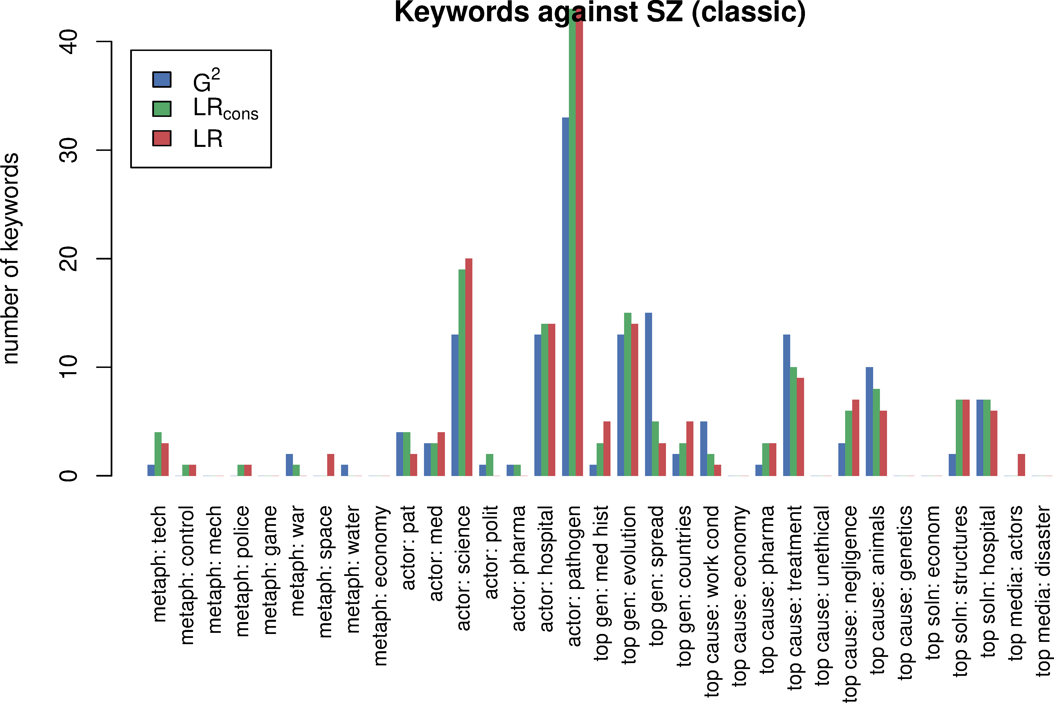
Recall = #KW for each category

Slide 32
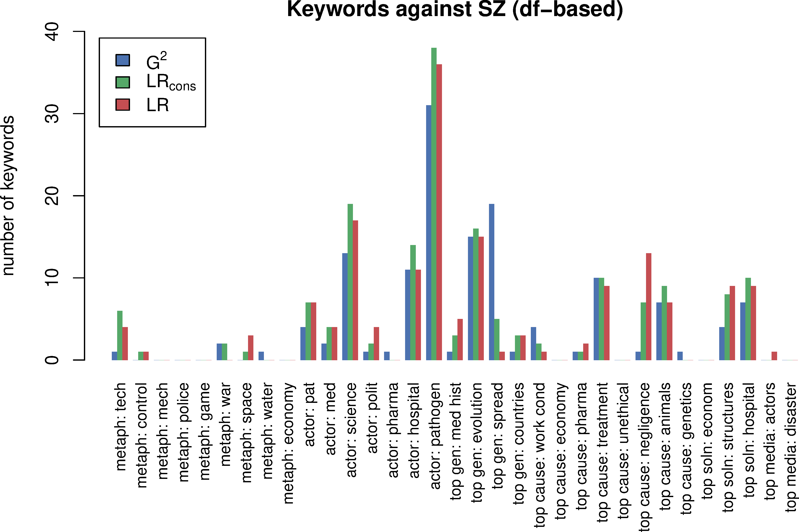
Recall = #KW for each category
keyword analysis seems rather blind towards metaphors!

Slide 33
A few quiz questions
Which is the best keyness measure?
What impact has the choice of reference corpus?
How many keywords should you look at?
Should you only consider significant keywords? Why?
What's the best way of reading a keyword list? Ranked by keyness? Alphabetical? Word cloud? …
What is “keyness” really?
What are limitations of keyword analysis?
NB: None of these questions has a clear-cut answer!

Slide 34
Computing Keywords with R
Interactive session

Slide 35
What you will need
R from https://cran.r-project.org
RStudio from https://posit.co/downloads/
R packages (install via RStudio)
tidyverse (to manipulate frequency lists)
corpora version 0.6 (or newer)
Rtsne, ggrepel (for a really cool visualisation)
fastTextR (to apply this visualisation to your own data)
RStudio project with data sets & worked example
provided as ZIP archive 04_keyness_hands_on.zip

Slide 36
Interoperability
At least three steps in a keyword analysis
pre-processing & linguistic annotation of corpora A and B
extraction of frequency data (optionally with filters, df counts, dispersion-adjusted frequencies, etc.)
statistical analysis ➞ keyness measures & beyond
optional 4th step: visualisation (scattertext, semantic map, …)
Many end-user tools integrate all three steps (CQPweb, AntConc, WordSmith)
… but better to use specialised state-of-the art tools for each step (in particular, R for statistical analysis)

Slide 37
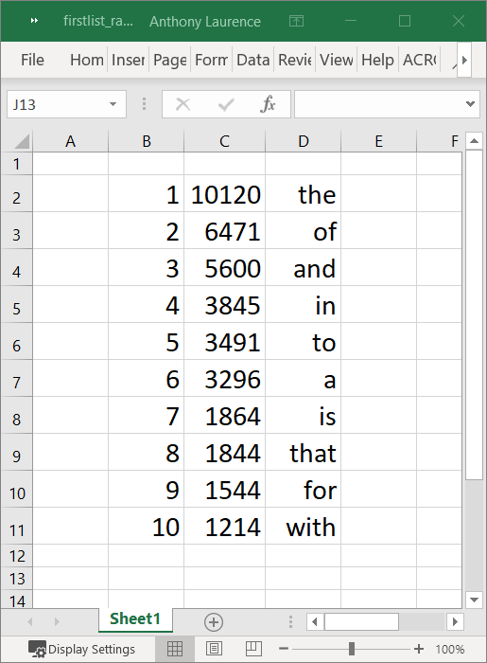
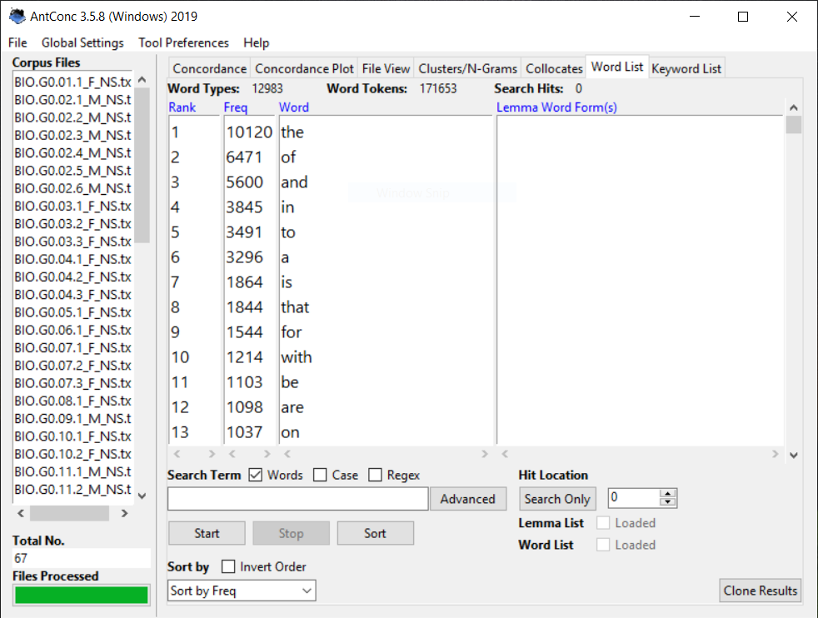

Interoperability with tabular data
Tabular data in MTSV format (Anthony & Evert 2019)
data set = collection of TAB-delimited tables
word frequencies, positional data (for dispersion), kwic, …
important: link back from statistical analysis to corpus

Slide 38
MTSV for keywords
freqlist
type | frequency | _reference
the | 2 | {"corpus": "xyz", "search": "the", "case": "0", …}
cat | 1 | {"corpus": "xyz", "search": "cat", "case": "0", …}
mat | 1 | {"corpus": "xyz", "search": "mat", "case": "0", …}
on | 1 | {"corpus": "xyz", "search": "on", "case": "0", …}
sat | 1 | {"corpus": "xyz", "search": "sat", "case": "0", …}
target
meta
_semantic_model | size | types | case | kind | threshold | comments
type_frequency_list | 7 | 6 | lower | token_counts | 1 | Target corpus frequency list
freqlist
type | frequency | _reference
the | 23383 | {"corpus": "xyz", "search": "the", "case": "0", …}
cat | 0 | {"corpus": "xyz", "search": "cat", "case": "0", …}
mat | 282 | {"corpus": "xyz", "search": "mat", "case": "0", …}
on | 2582 | {"corpus": "xyz", "search": "on", "case": "0", …}
sat | 7892 | {"corpus": "xyz", "search": "sat", "case": "0", …}
reference
meta
_semantic_model | size | types | case | kind | threshold | comments
type_frequency_list | 19238145 | 8293 | lower | token_counts | 1 | Reference corpus frequency list

Slide 39
Tabular data in practice
Little support for MTSV yet, except for AntConc
How to obtain MTSV word frequency lists:
open desired corpus as Target Corpus
create word frequency list (in Word tab)
select Save Current Tab Database Tables from menu
creates ZIP archive with several CSV tables
But most tools can easily read/write tabular files: CQPweb, WordSmith, CWB, Python, R, Excel, …
we'll look at examples from AntConc, CWB and CQPweb

Slide 40
Tabular data in practice
CSV = comma-separated values (RFC 4180)
https://datatracker.ietf.org/doc/html/rfc4180
comma-separated columns (usually), values double-quoted if necessary, data types of columns inferred from values
TSV = TAB-delimited text files
columns delimited by TAB characters (ASCII 0x09, "\t")
no quotes (values must not contain TABs or line breaks)
Strategy: export frequency lists for corpora A and B from favourite corpus tool + note down sample sizes
some corpus tools create “tidier” tabular data than others

Slide 41
And finally …
Hands on!
LRC reference implementation, example data and mathematical details at https://osf.io/cy6mw/
Implementation for end users: keyness() function in corpora package v0.6
Unpack ZIP archive keyness_hands_on.zip then double-click the .Rproj file to open RStudio

Slide 42
Visualising keywords
Interactive session

Slide 43
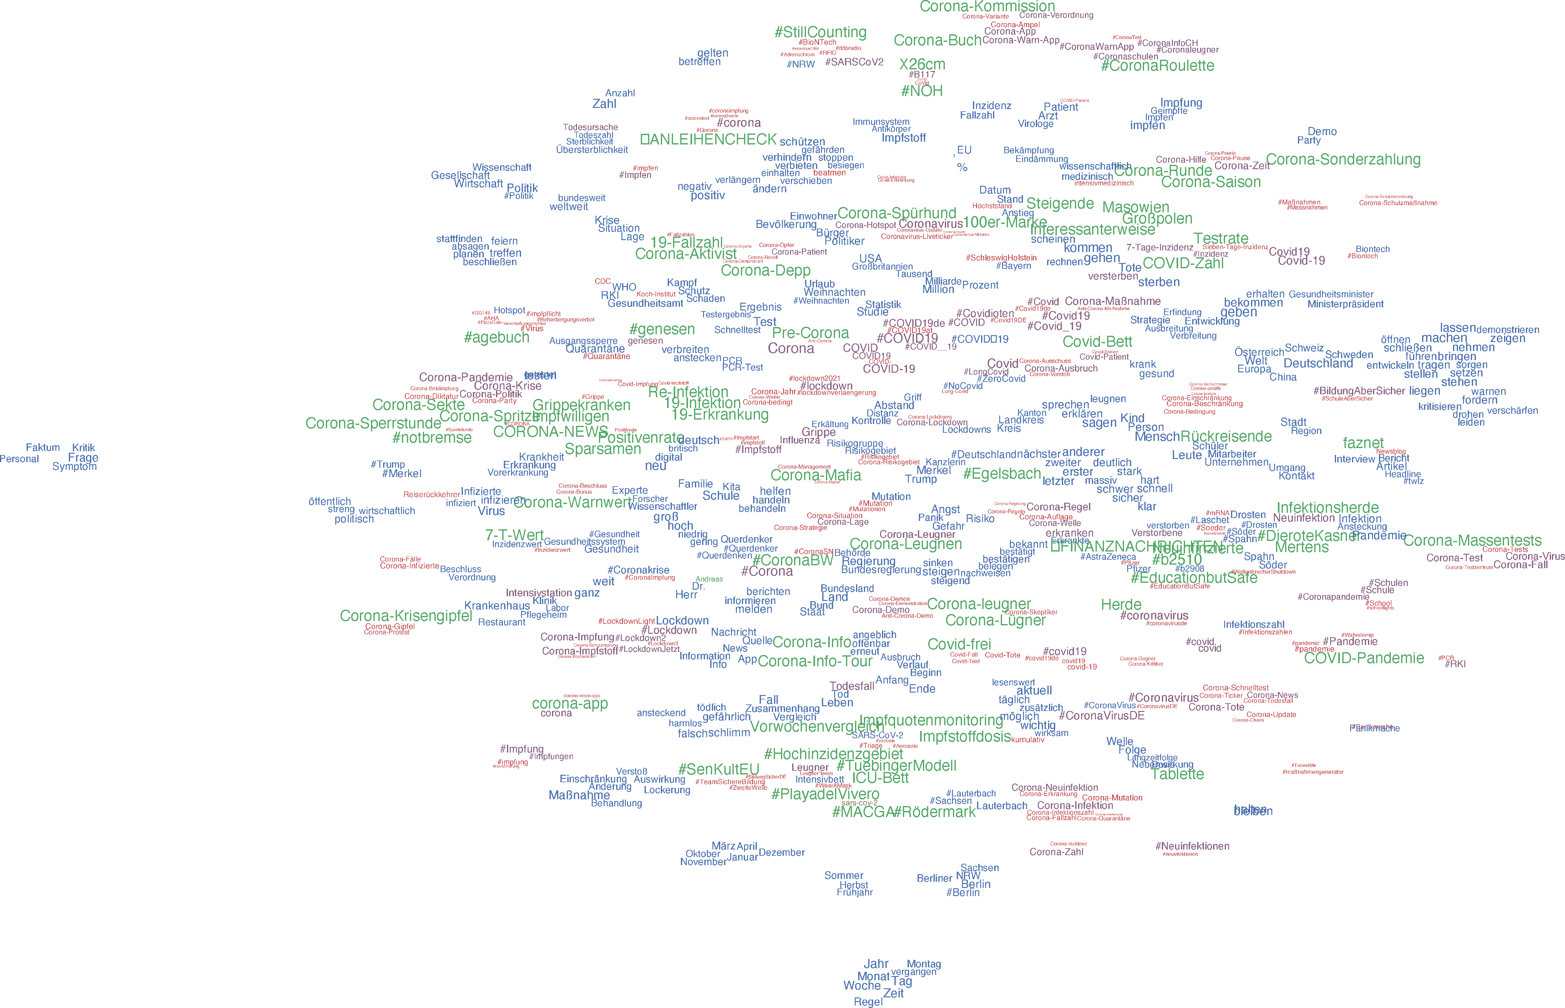

Visualisation as semantic map

Slide 44
Visualisation as semantic map

Slide 45
Visualisation as semantic map
#PizzaGate
Corona-Diktatur

Slide 46
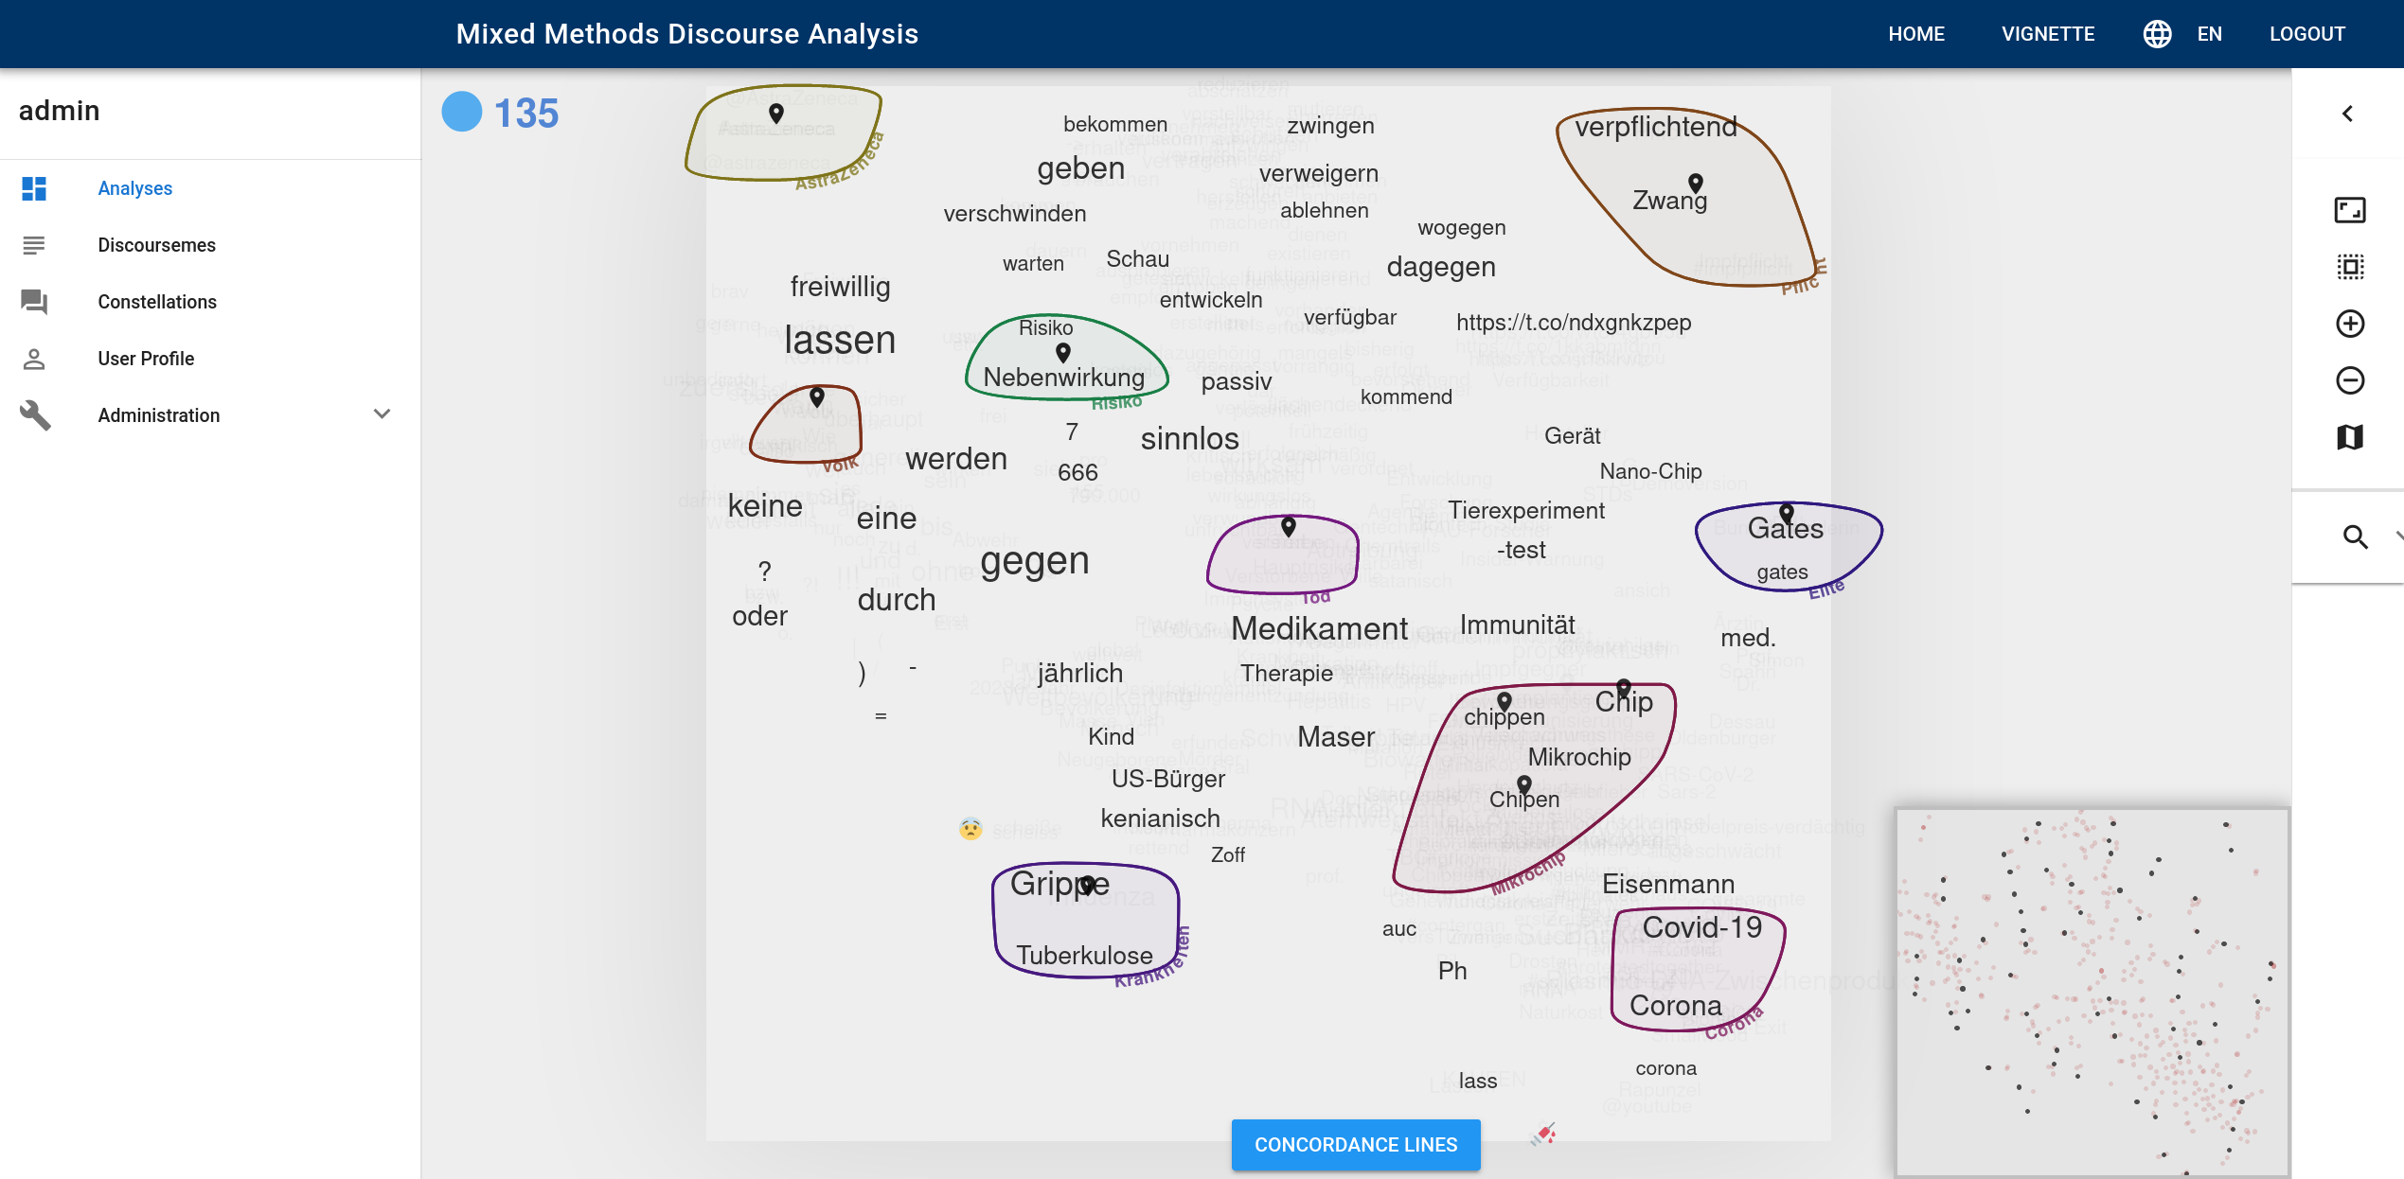

Interactive grouping with MMDA
Kollokationen
zu Impfung
https://www.linguistik.phil.fau.de/projects/efe/mmda-toolkit/
Exploring the Fukushima Effect

Slide 47
What is keyness?
Interactive session

Slide 48
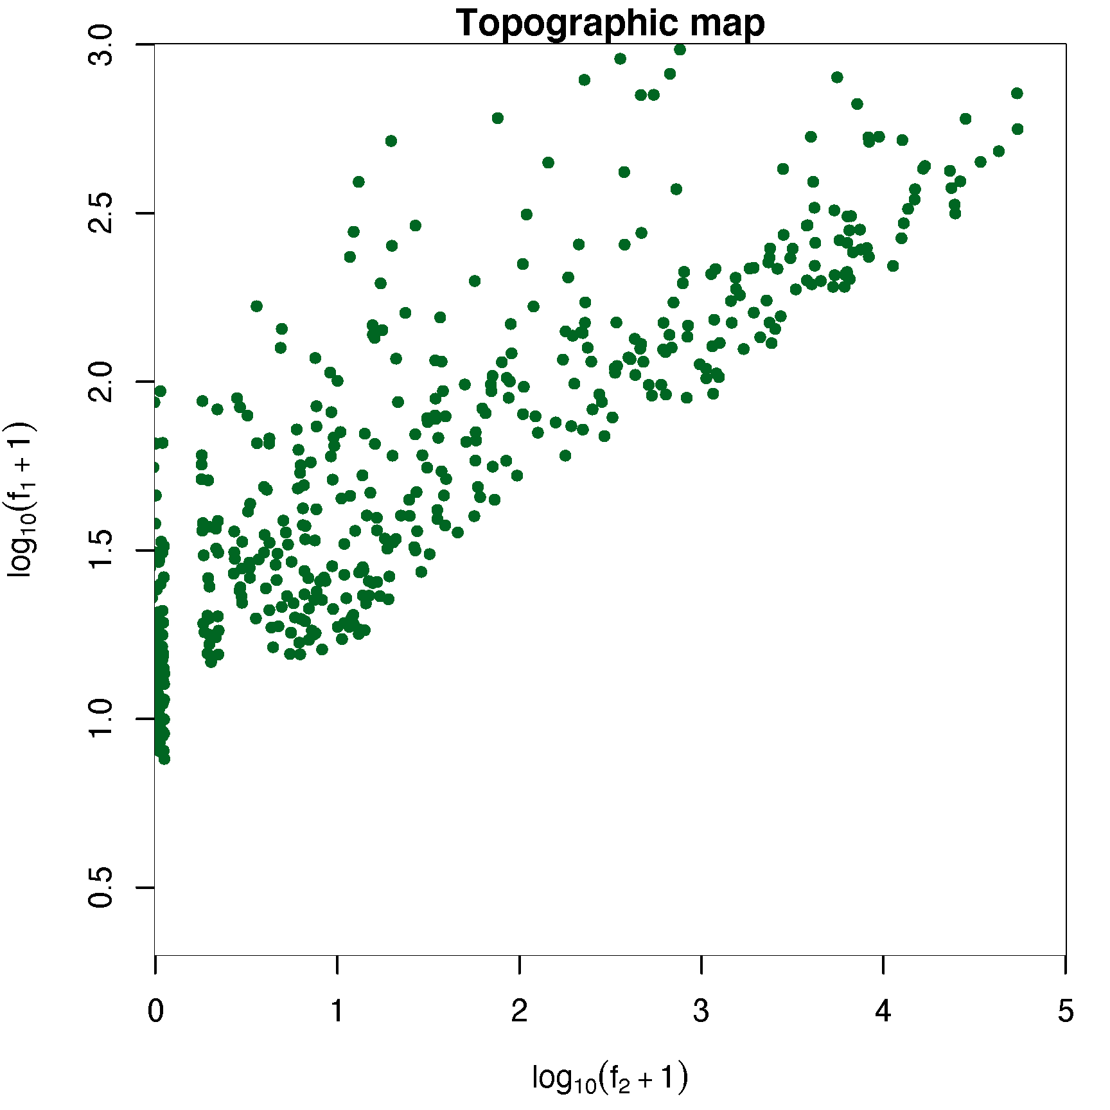
Understanding keyness measures
Candidates from data set of Evert et al. (2018) that are among top-250 keywords for any of several keyness measures
Topographic map visualises f₁ vs. f₂ (sufficient since n₁ and n₂ are fixed for data set) on a logarithmic scale ➞ similar to ScatterText
https://spacy.io/universe/project/scattertext

Slide 49
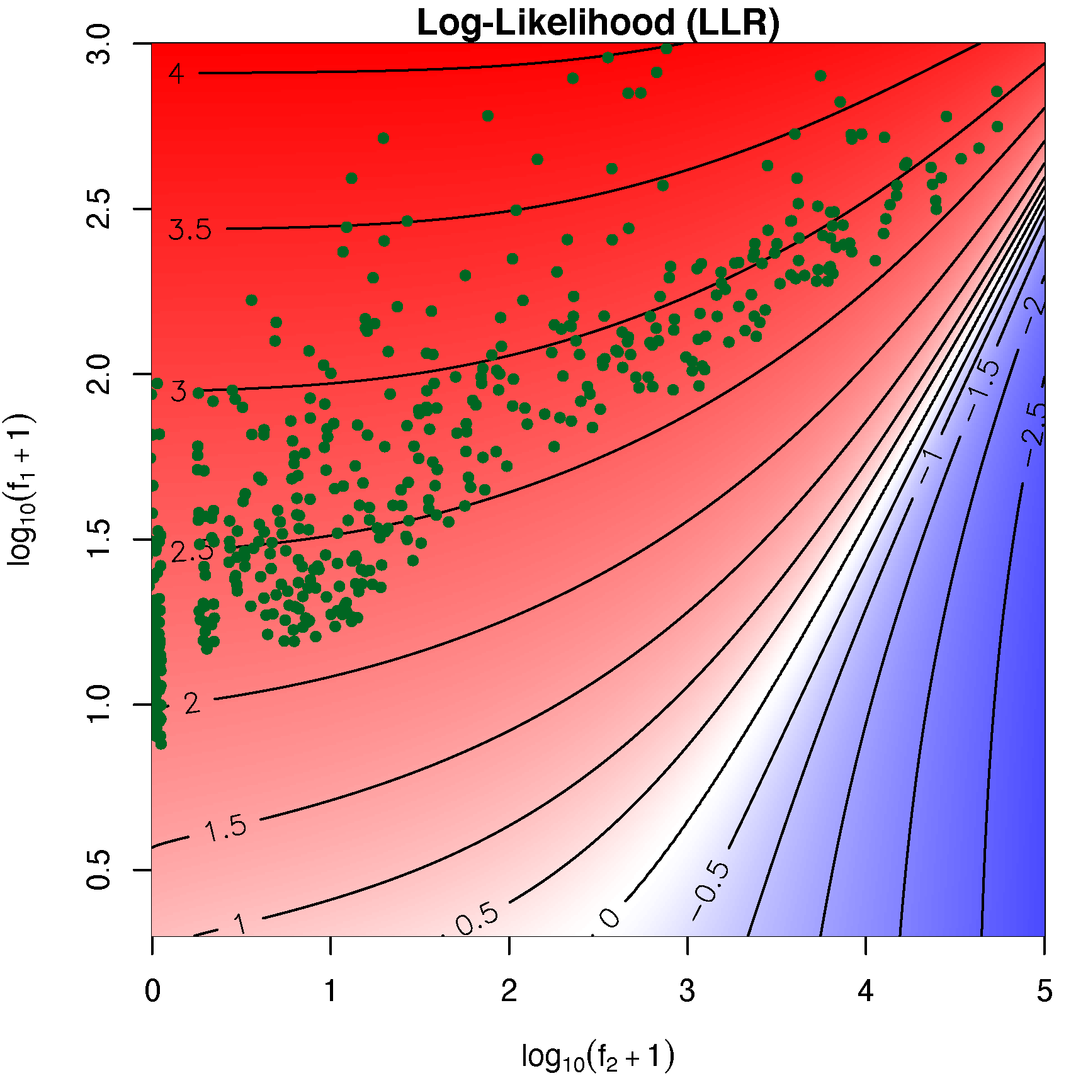
Topographic maps
Topographic map visualises f₁ vs. f₂ (sufficient since n₁ and n₂ are fixed for data set) on a logarithmic scale ➞ similar to ScatterText
https://spacy.io/universe/project/scattertext

Slide 50
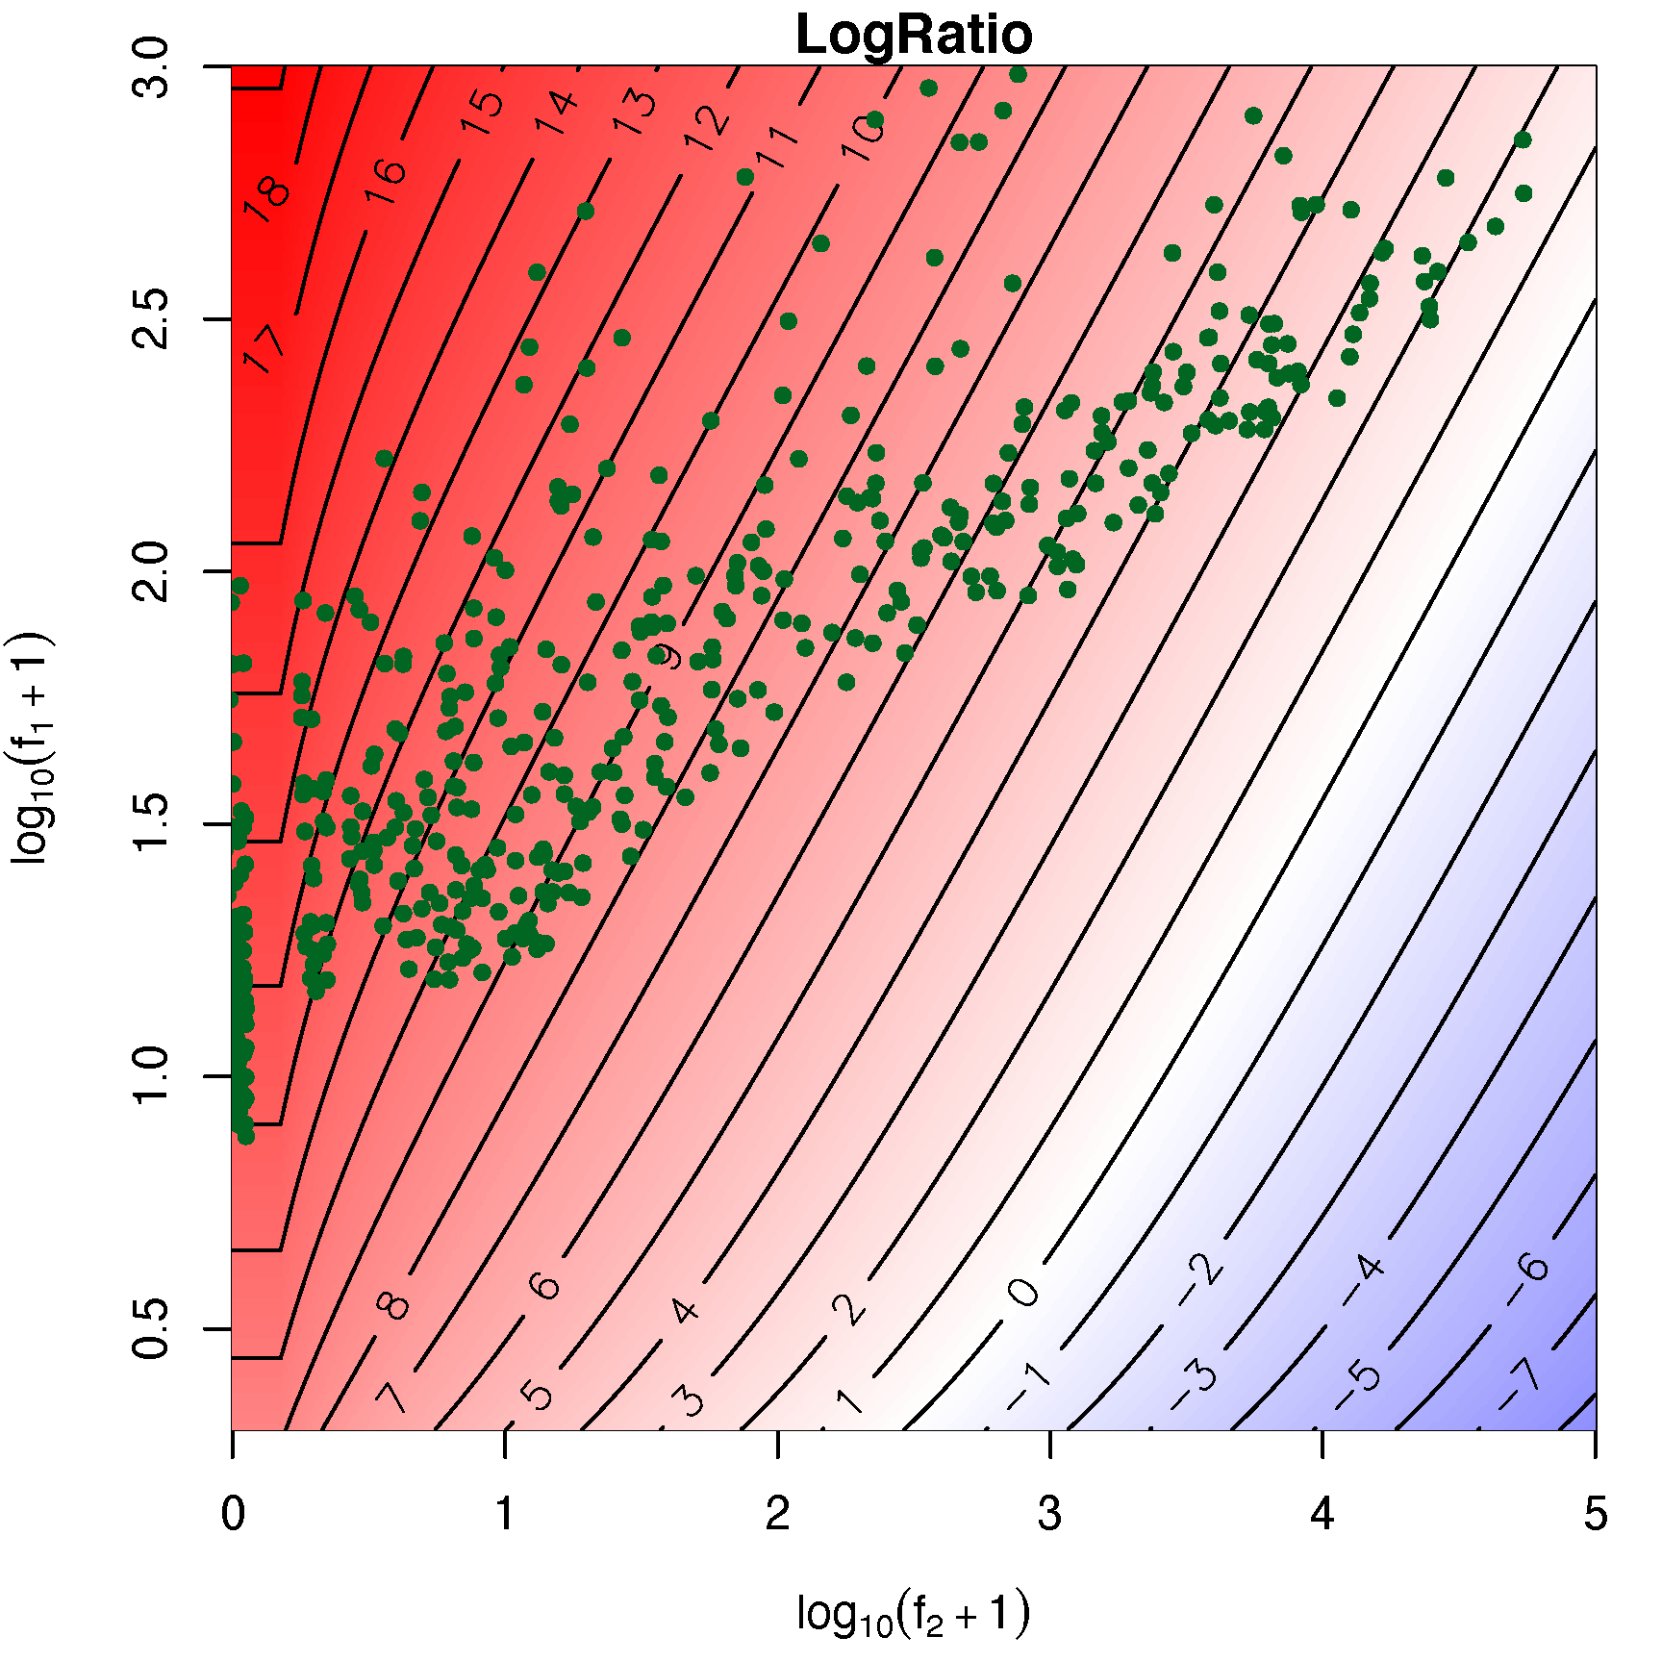
Topographic maps

Slide 51
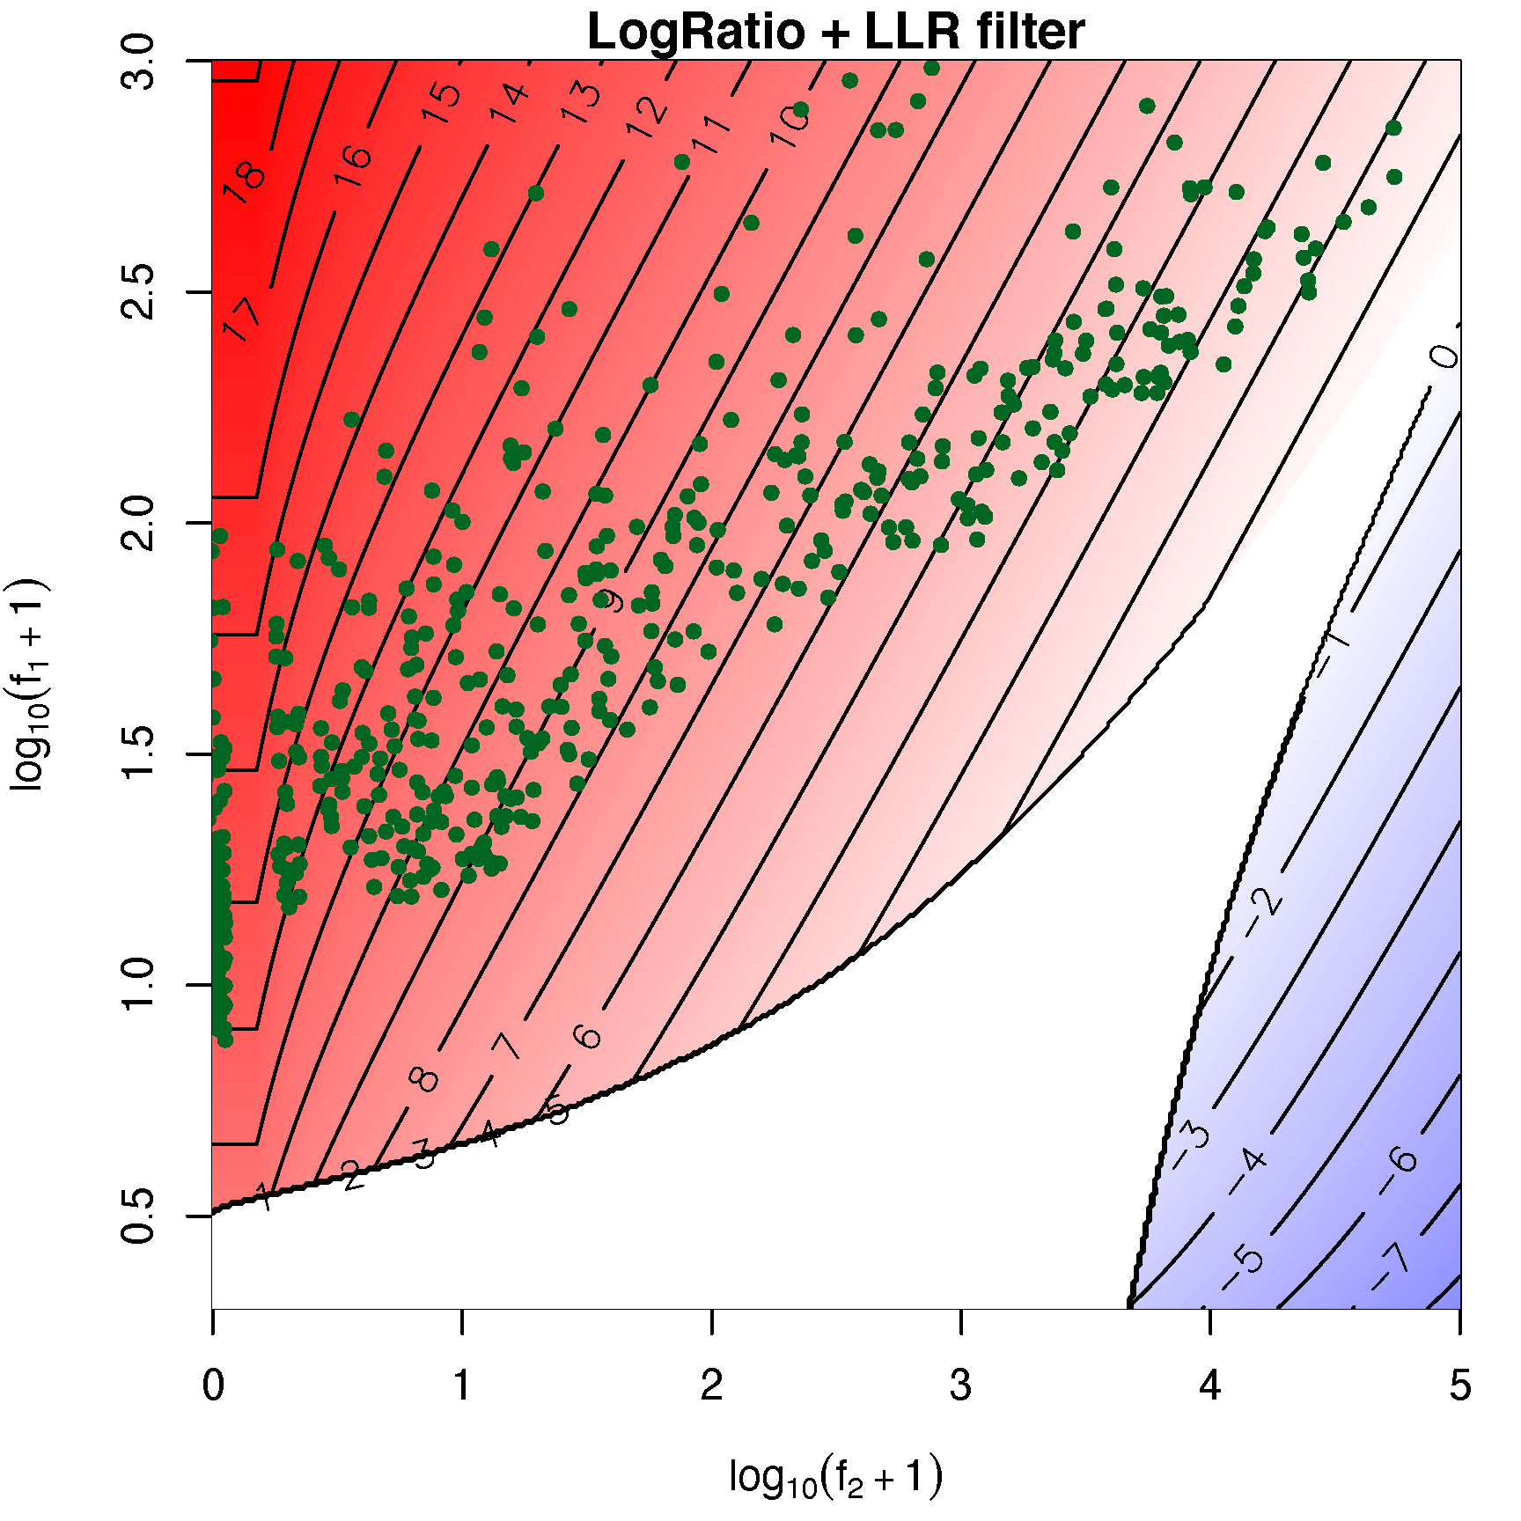
Topographic maps

Slide 52
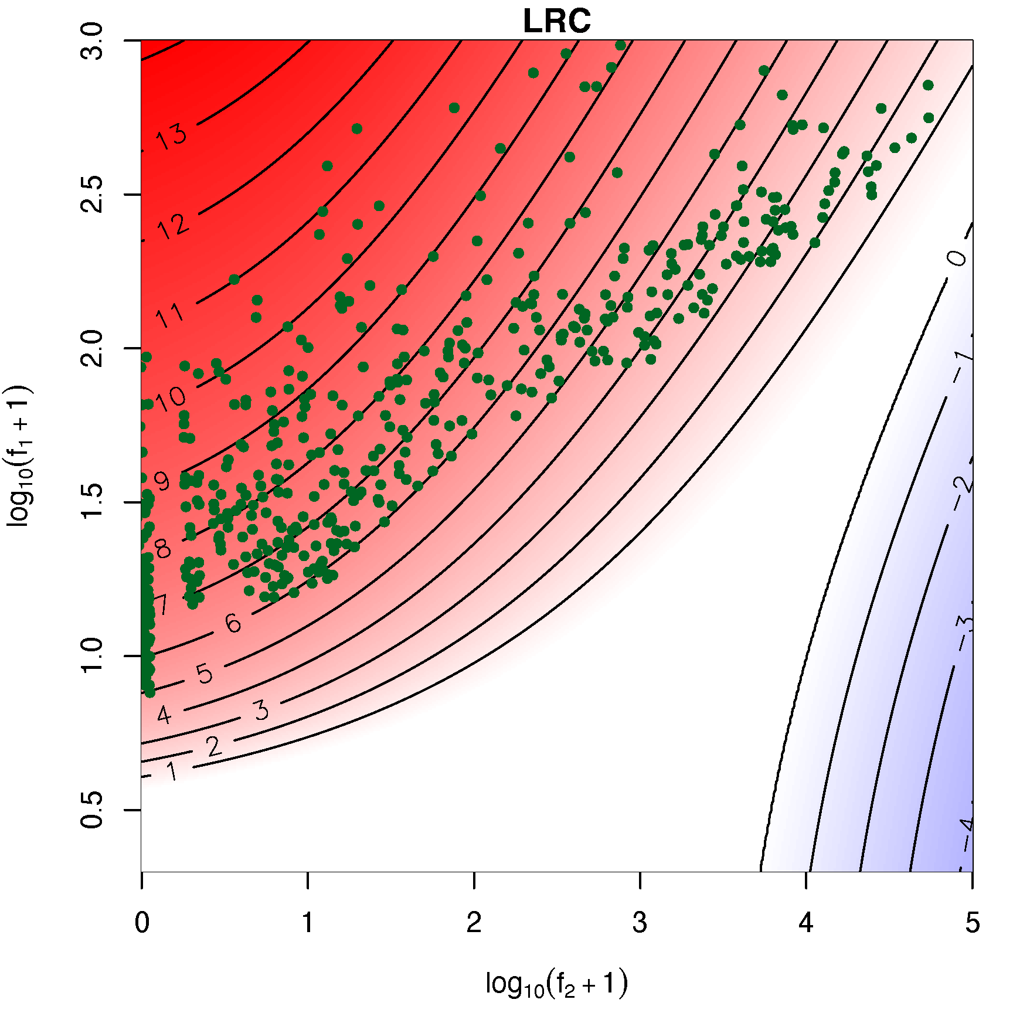
Topographic maps

Slide 53
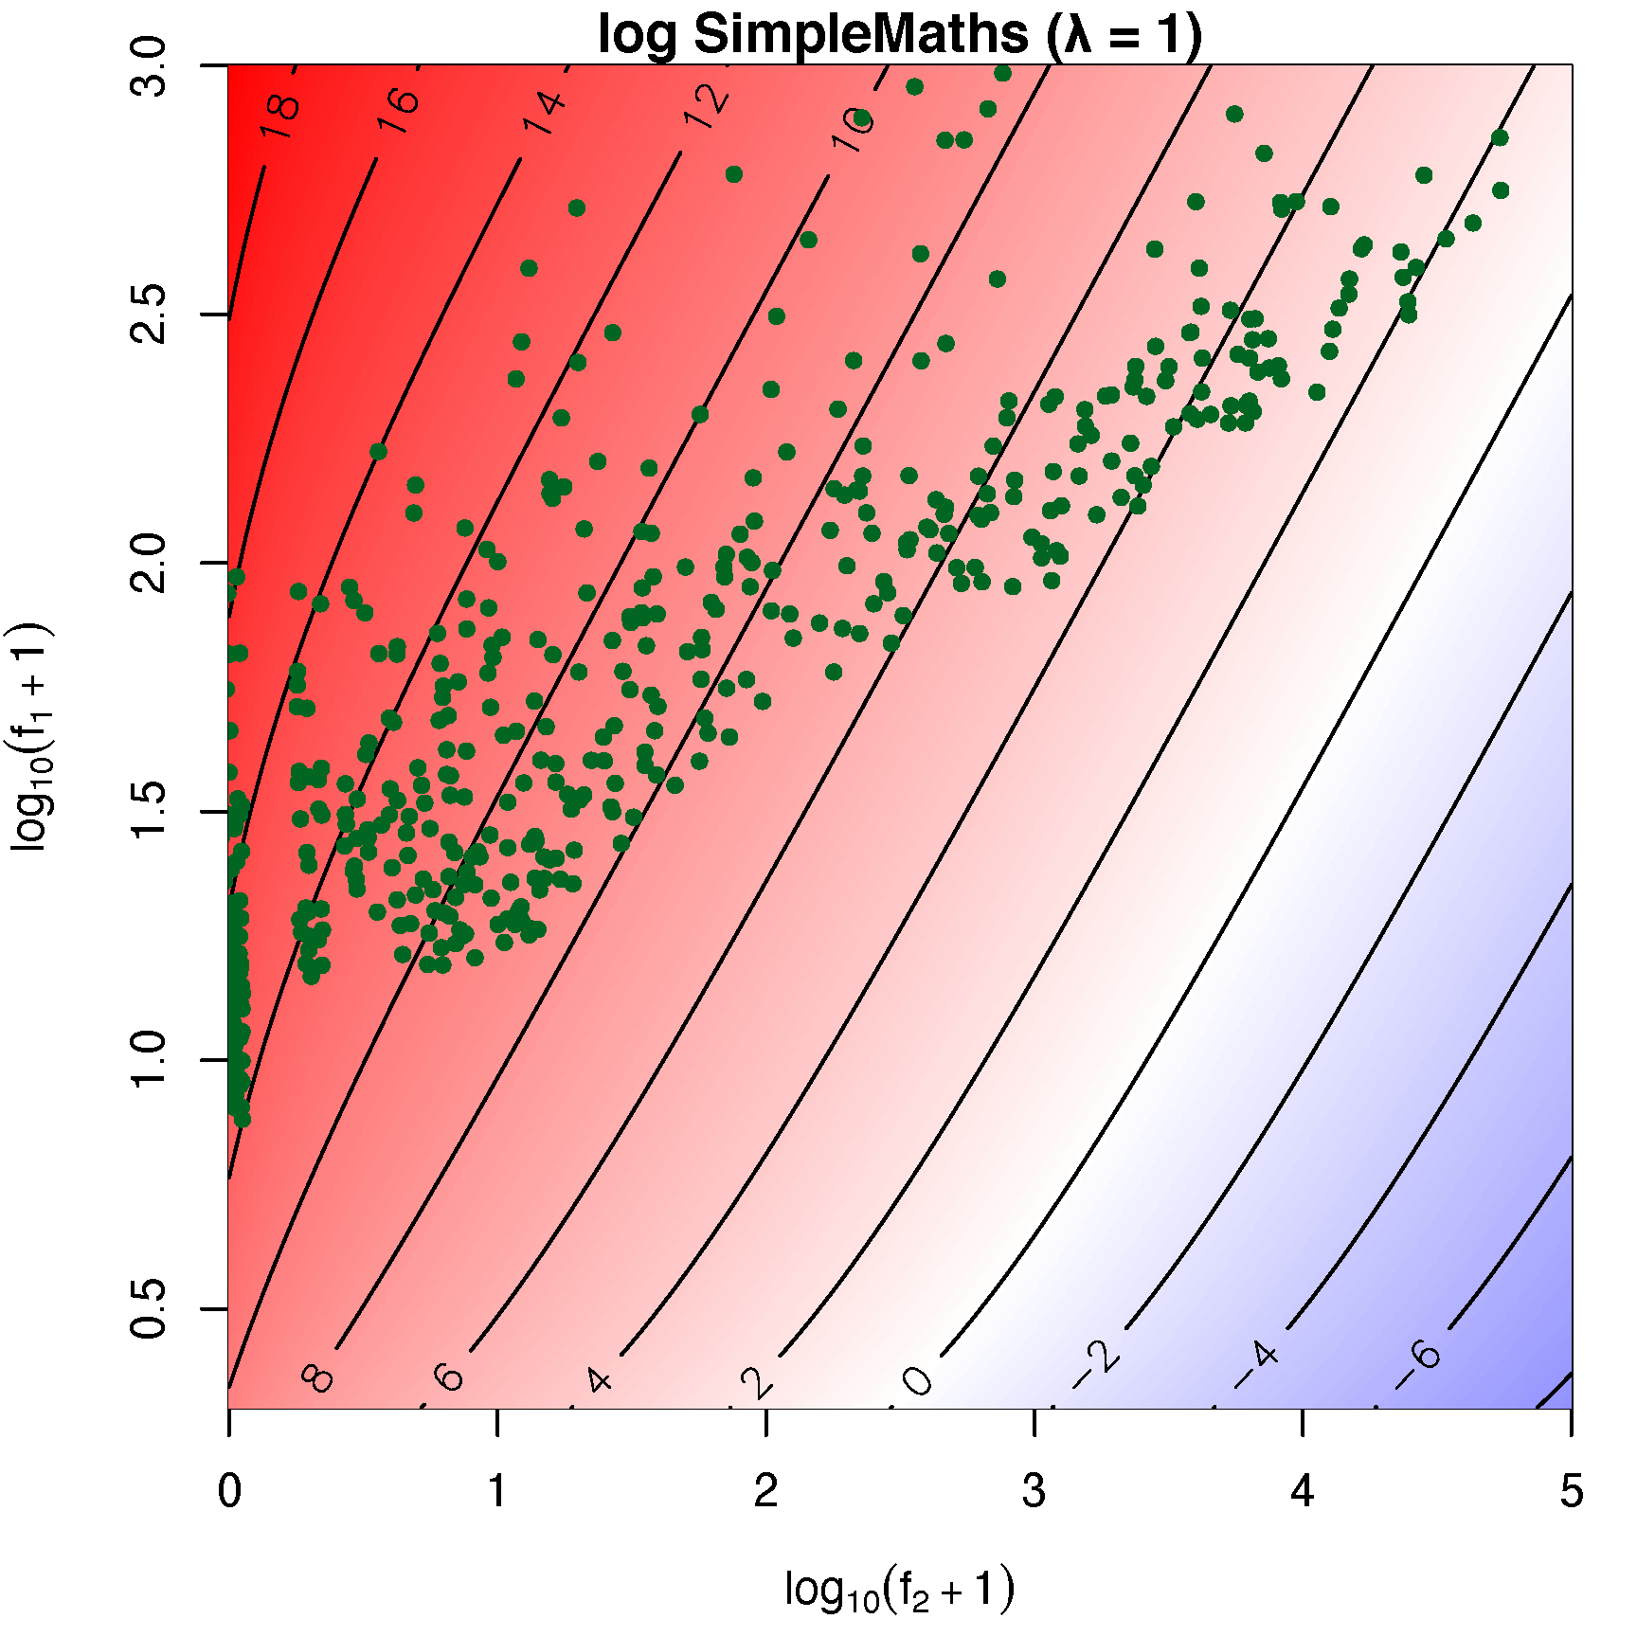
Topographic maps

Slide 54
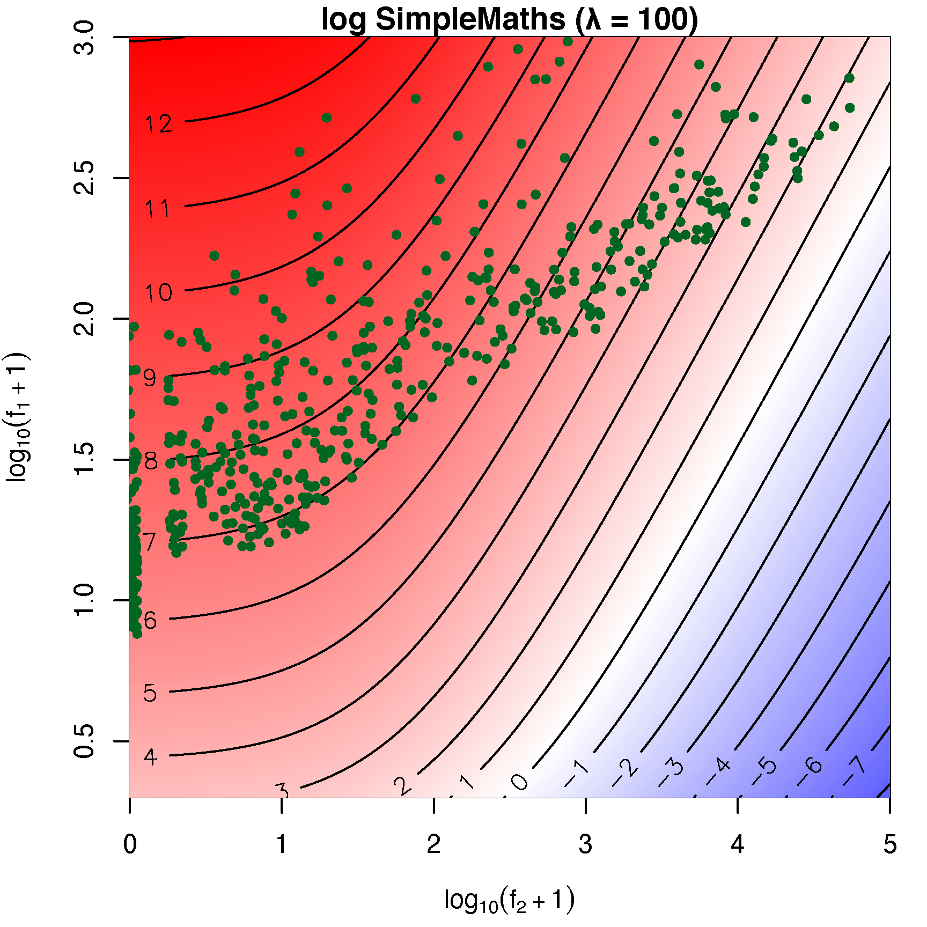
Topographic maps

Slide 55
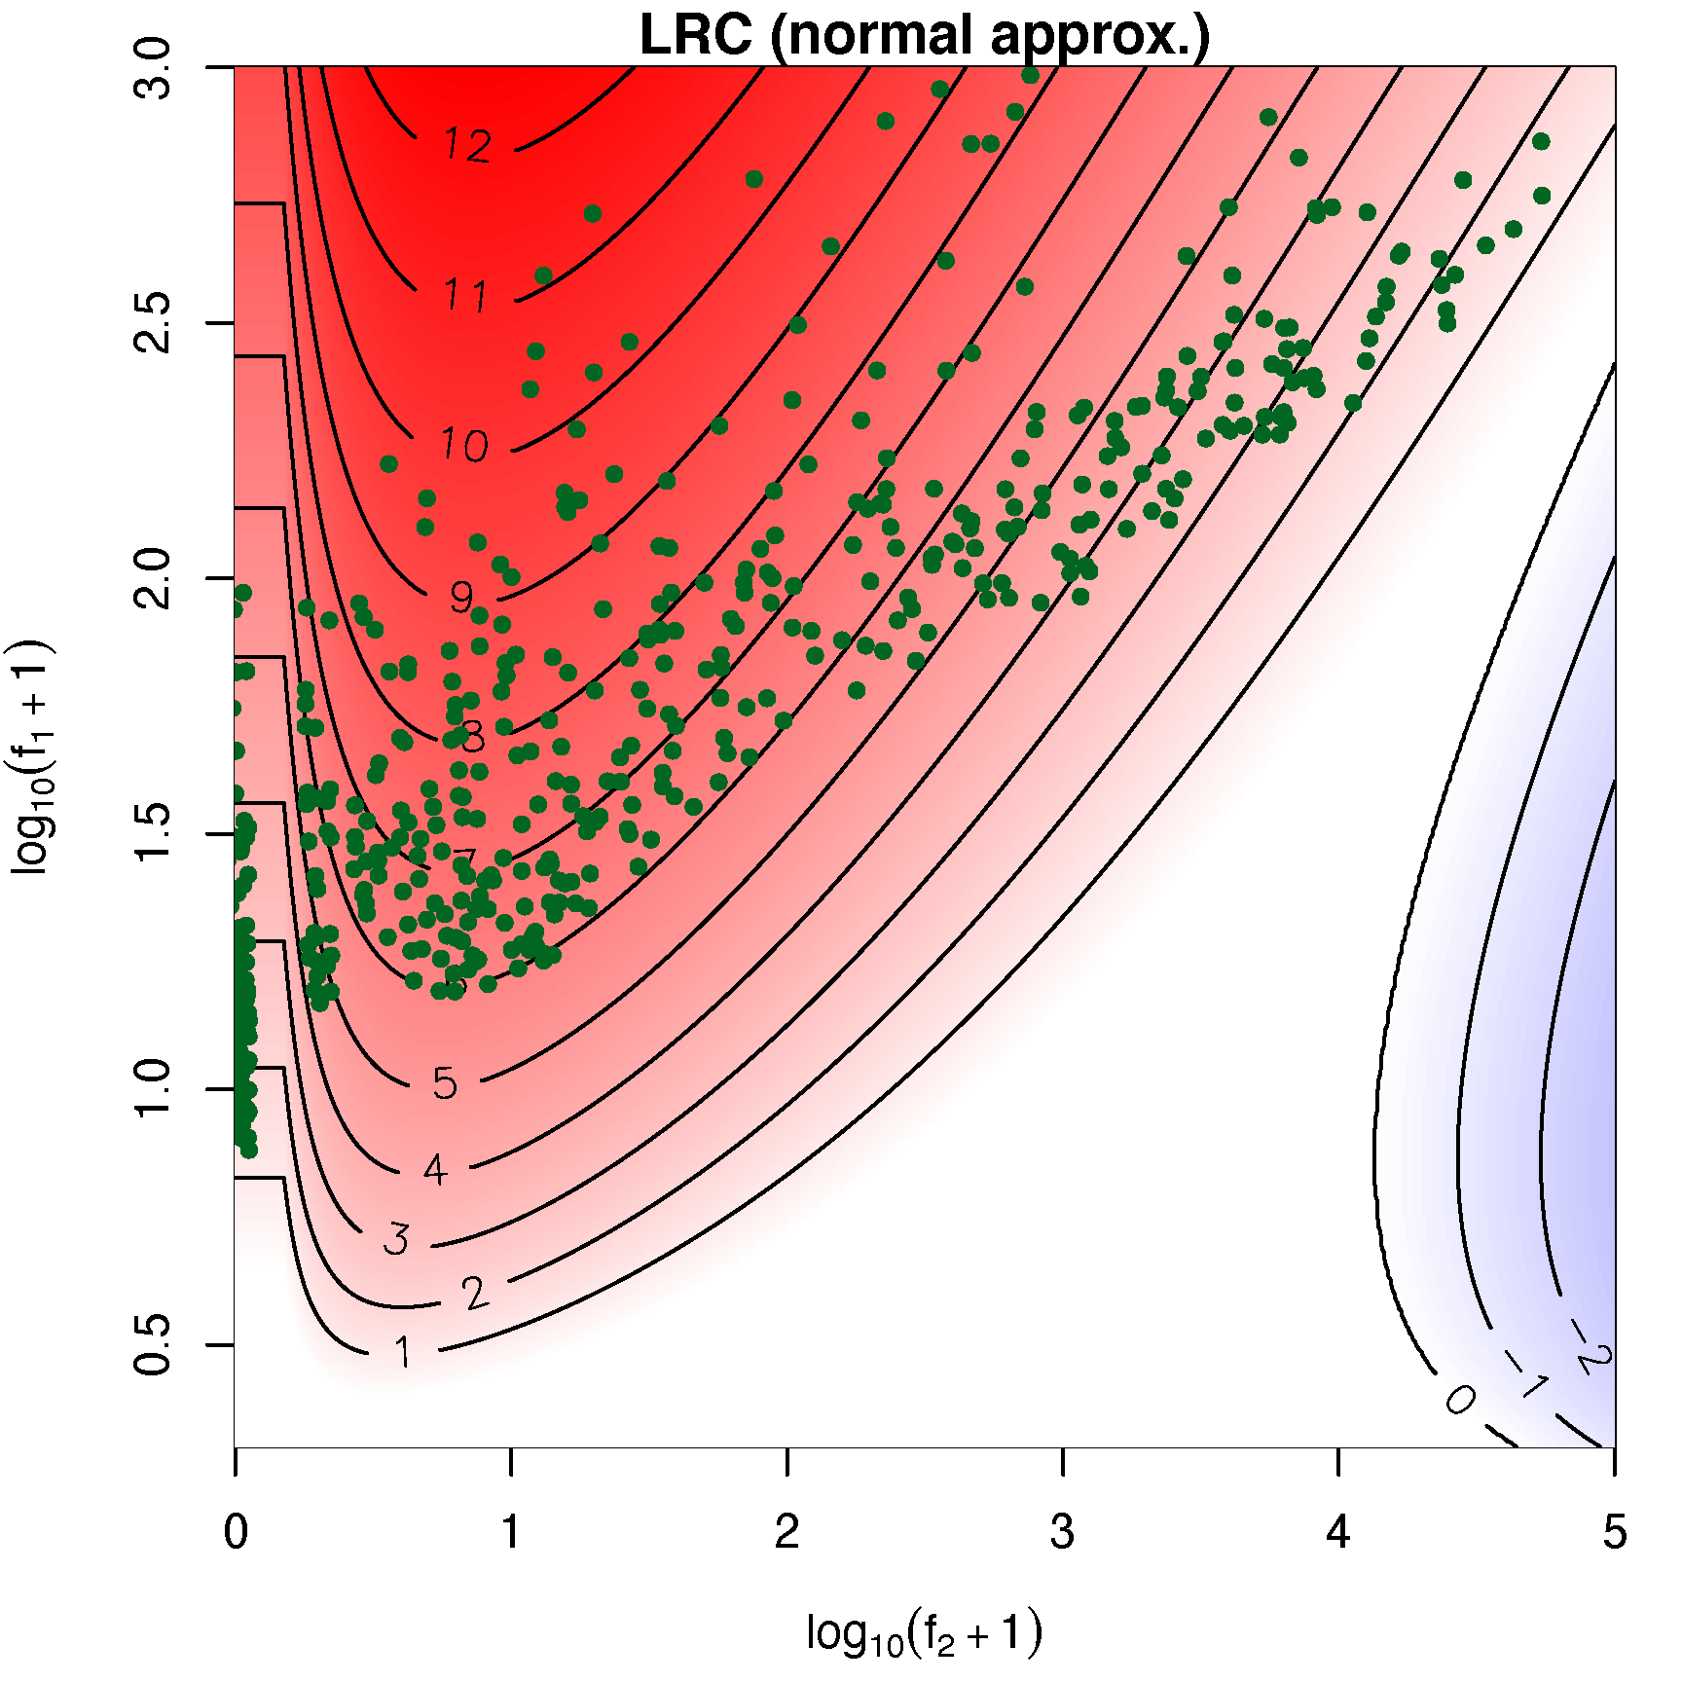
Topographic maps

Slide 56
Finding Metaphors
Interactive session

Slide 57
Finding better keywords
Keyness as simple frequency comparison very limited
But more sophisticated approaches often share its limitations ➞ still based on surface frequencies
Certain types of keywords (terminology, topics) are easy to detect, other seem to be very challenging
Perhaps more knowledge-rich approaches needed!
Let's get back to case study from Evert et al. (2018)

Slide 58
Recall = #KW for each category
keyword analysis seems rather blind towards metaphors!

Slide 59
Why so few metaphor keywords?
Possible causes:
No metaphors in online media discourse (unlikely)
Cannot be reduced to single words
Keywords occur, but are too infrequent

Slide 60
A case study
List of plausible keywords for each metaphor category from thesaurus (Dornseiff 2004)
e.g. police: Indiz clue, Killer killer, Mord murder, Täter culprit, fahnden search, heimtückisch insidious, …
manually validated against concordance in target corpus
Comparison with full set of keyword candidates
frequency in target corpus
removed because of reference corpus threshold?
keyness score and rank in candidate set

Slide 61
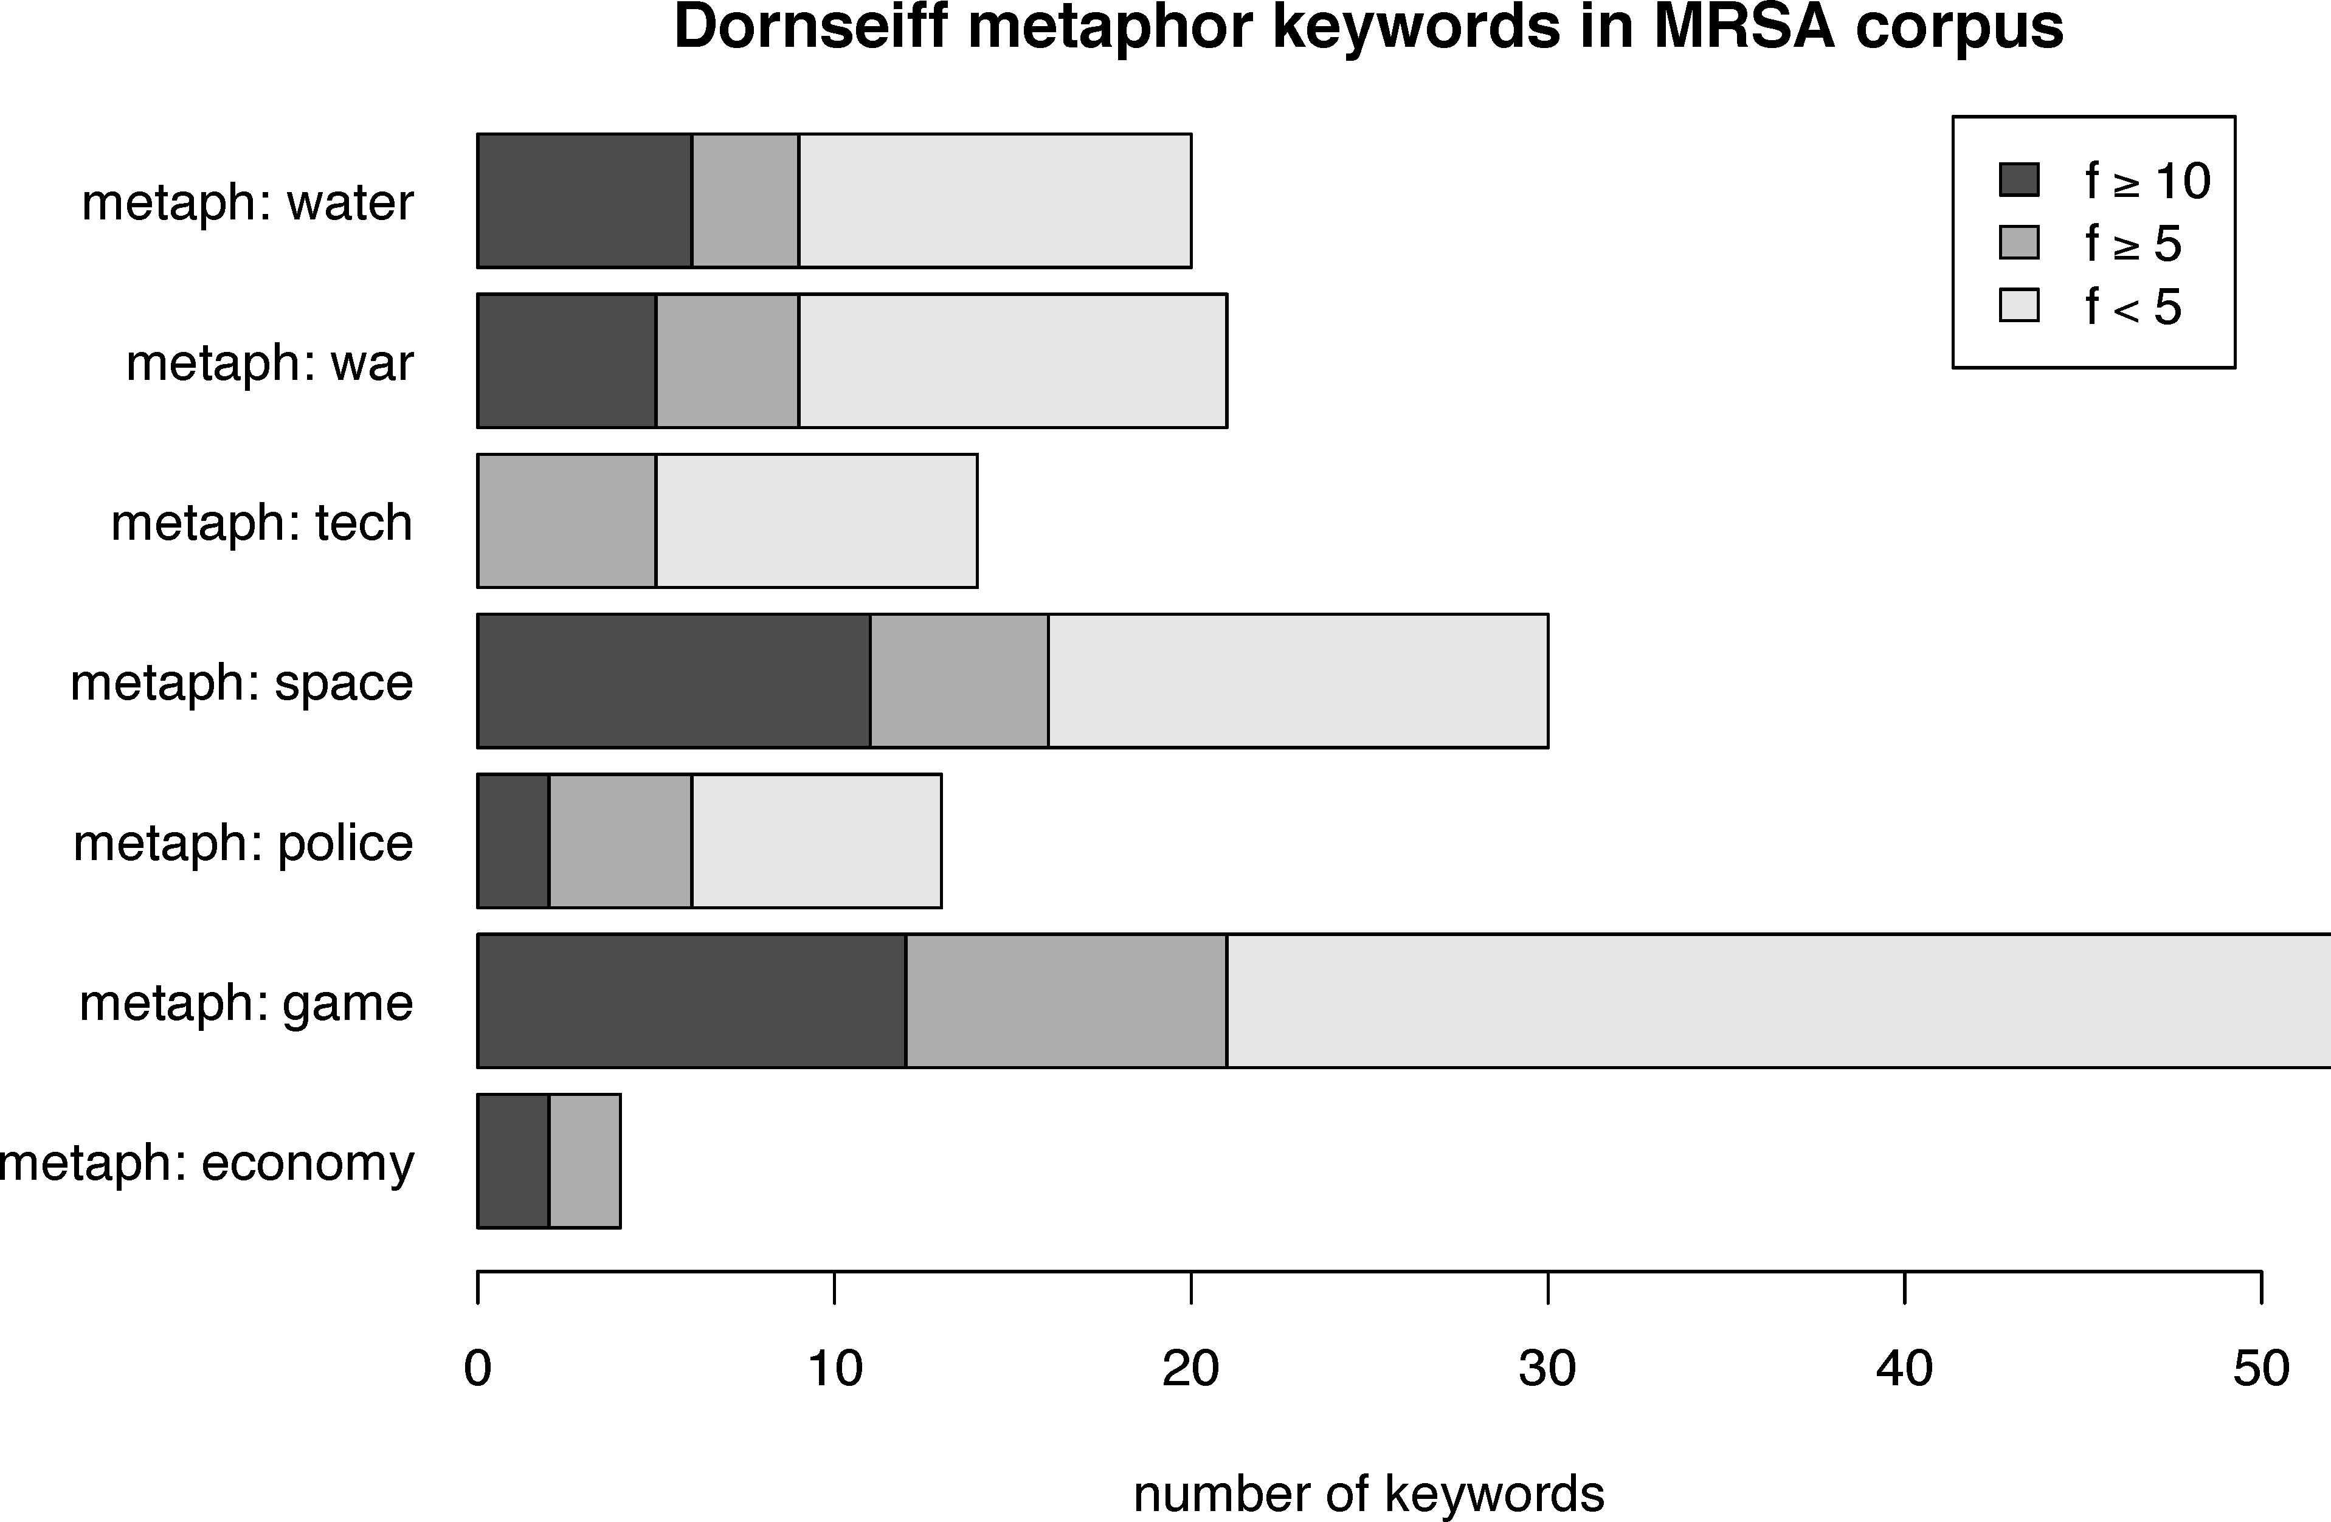
A case study

Slide 62
Finding metaphor keywords
Substantial number of plausible keywords for all metaphor categories except economy
frequent in target corpus & pass threshold in reference
but very low ranks (> 1000) from all keyness measures
Reason: literal senses very frequent in reference
aggregating all keywords from category doesn't help
Approximate semantics with distributional context vectors (Schütze 1998)
three-sentence context around each potential keyword
bag-of-words centroids of word embeddings
MRSA contexts clearly separated from reference contexts?

Slide 63
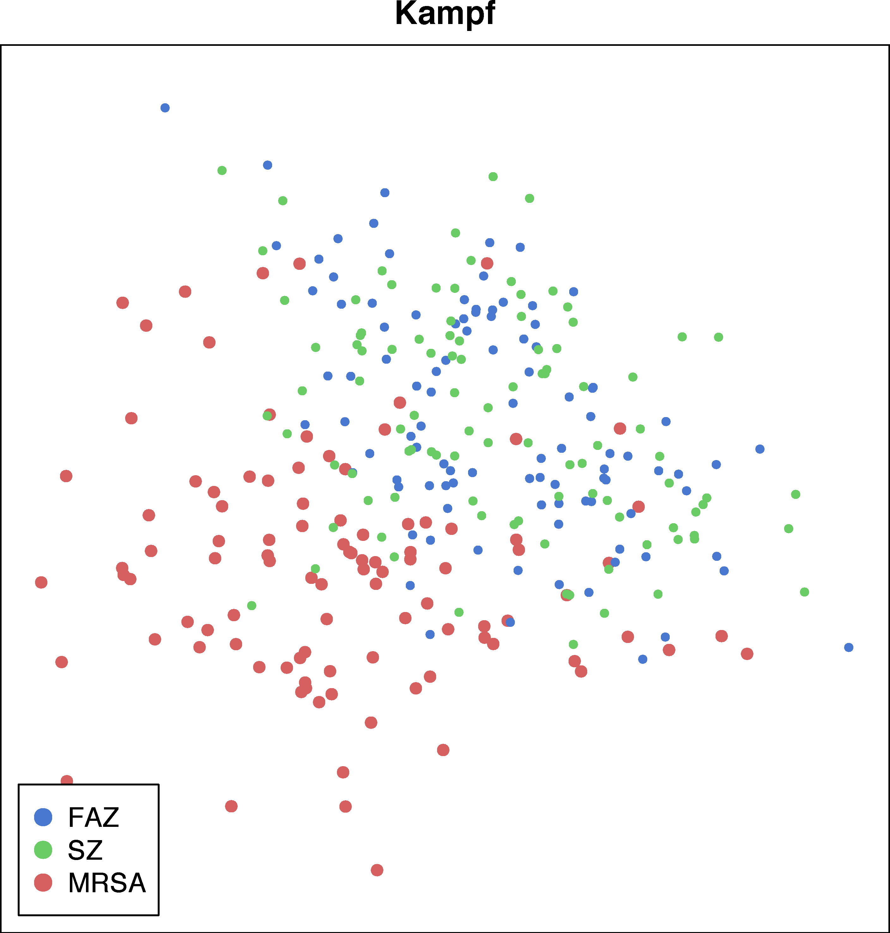
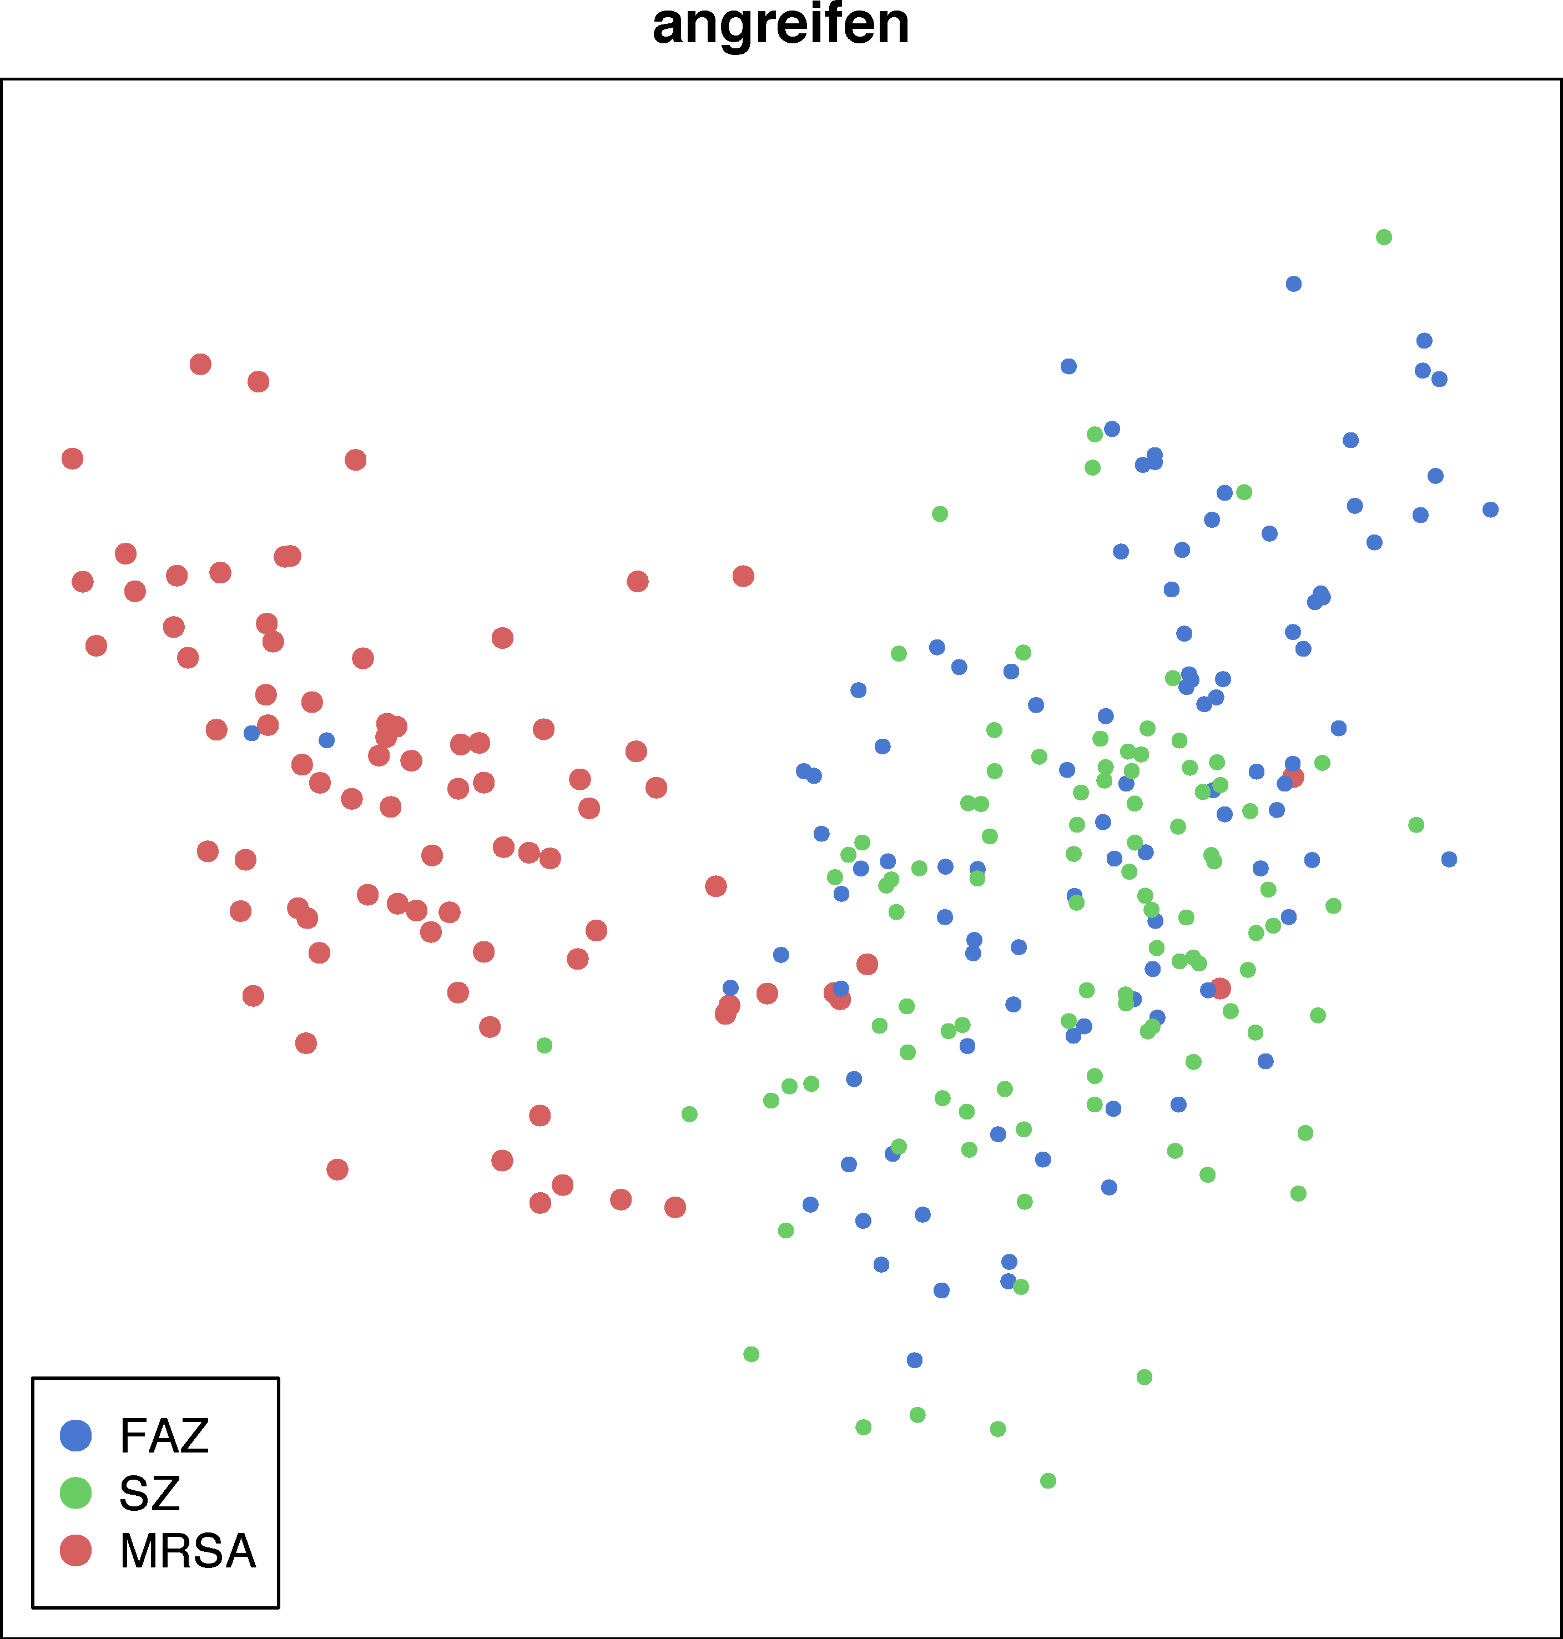
Finding metaphor keywords

Slide 64
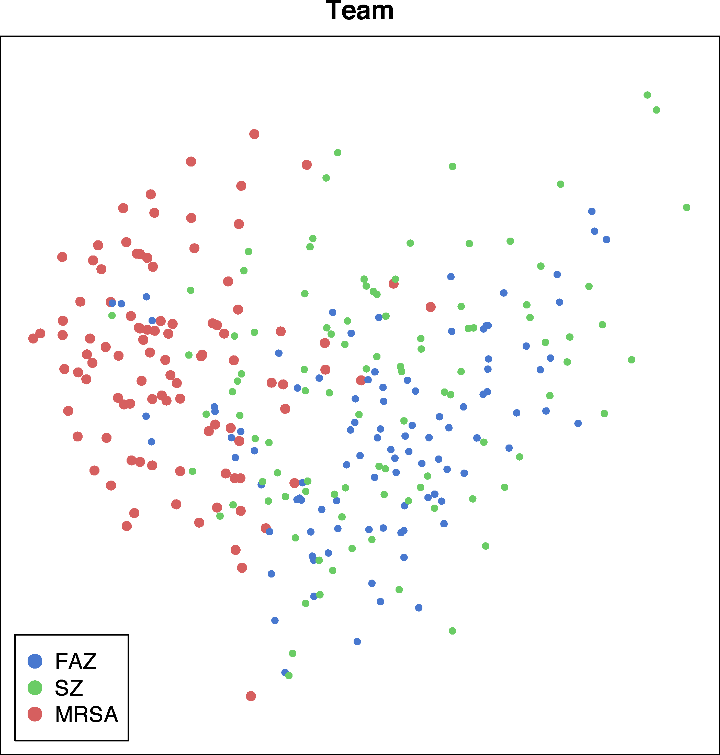
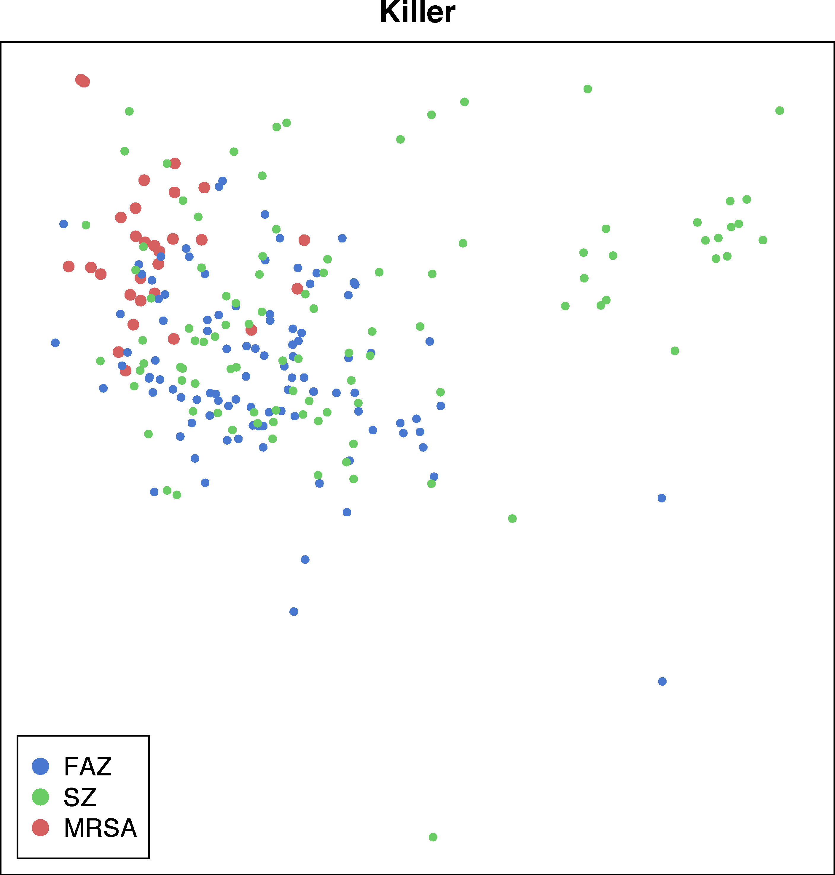
Finding metaphor keywords

Slide 65
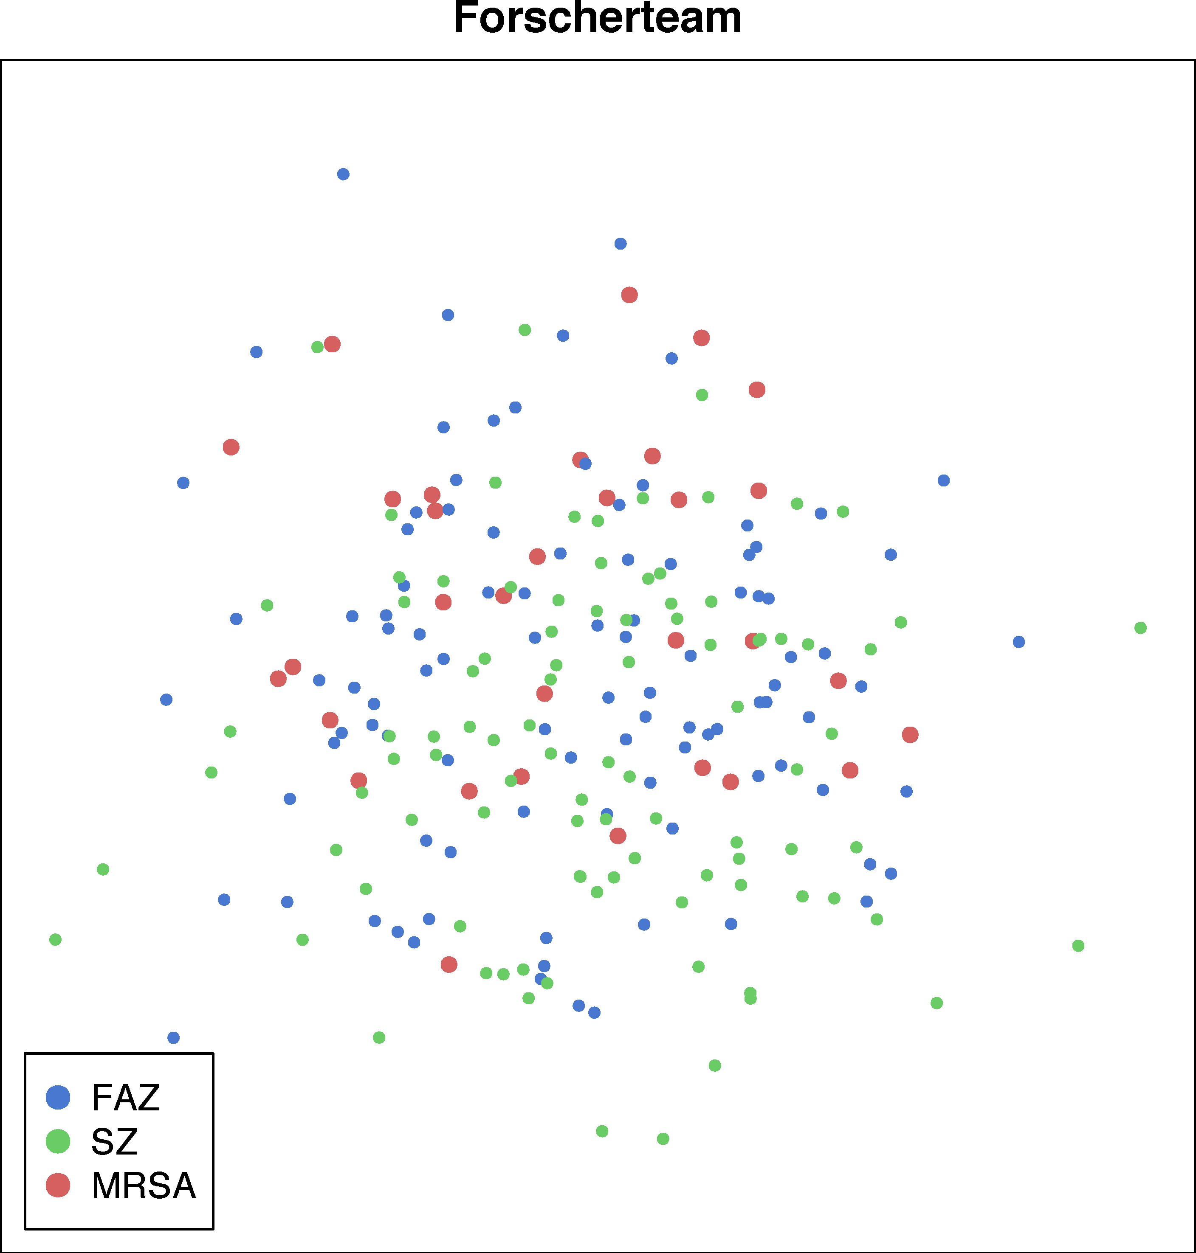
Finding metaphor keywords

Slide 66
References I
Anthony, L. and Evert, S. (2019). Embracing the concept of data interoperability in corpus tools development. In Proceedings of the Corpus Linguistics 2019 Conference, Cardiff, UK.
Baroni, M. and Bernardini, S. (2004). BootCaT: Bootstrapping corpora and terms from the Web. In Proceedings of LREC 2004, pages 1313–1316, Lisbon, Portugal.
Baker, P. (2006). Using Corpora in Discourse Analysis. Continuum Books, London.
Culpeper, J. (2009). Keyness: Words, parts-of-speech and semantic categories in the character-talk of Shakespeare's Romeo and Juliet. International Journal of Corpus Linguistics, 14(1):29–59.
Dornseiff, F. (2004). Der deutsche Wortschatz nach Sachgruppen. De Gruyter, Berlin, 8th edition.
Egbert, J. and Biber, D. (2019). Incorporating text dispersion into keyword analyses. Corpora, 14(1):77–104.
Evert, S., Dykes, N., and Peters, J. (2018). A quantitative evaluation of keyword measures for corpus-based discourse analysis. Presentation at the Corpora & Discourse International Conference (CAD 2018), Lancaster, UK.

Slide 67
References II
Evert, S. (2022). Measuring keyness. In Digital Humanities 2022: Conference Abstracts, pages 202–205, Tokyo, Japan / online. https://osf.io/cy6mw/
Fay, M. P. (2010). Confidence intervals that match Fisher's exact or Blaker's exact tests. Biostatistics, 11(2):373–374.
Fidler, M. and Cvrcek, V. (2015). A data-driven analysis of reader viewpoints: reconstructing the historical reader using keyword analysis. Journal of Slavic Linguistics, 23(3):197–239.
Gabrielatos, C. and Marchi, A. (2012). Keyness: Appropriate metrics and practical issues. Presentation at the Corpora and Discourse Studies Conference (CADS 2012), Bologna, Italy.
Hardie, A. (2014). A single statistical technique for keywords, lockwords, and collocations. Internal CASS working paper no. 1, unpublished.
Kilgarriff, A. and Rose, T. (1998). Measures for corpus similarity and homogeneity. In Proceedings of the Third Conference on Empirical Methods for Natural Language Processing, pages 46–52, Granada, Spain.

Slide 68
References III
Kilgarriff, A. (2009). Simple maths for keywords. In Proceedings of the Corpus Linguistics 2009 Conference, Liverpool, UK.
Lafon, P. (1980). Sur la variabilité de la fréquence des formes dans un corpus. Mots. Les langages du politique, 1(1):127–165.
McEnery, T., McGlashan, M., and Love, R. (2015). Press and social media reaction to ideologically inspired murder: the case of Lee Rigby. Discourse and Communication, 9(2):1–23.
Oakes, M. P. and Farrow, M. (2006). Use of the chi-squared test to examine vocabulary differences in English language corpora representing seven different countries. Literary and Linguistic Computing, 22(1):85–99.
Paquot, M. and Bestgen, Y. (2009). Distinctive words in academic writing: a comparison of three statistical tests for keyword extraction. In Jucker, A., Schreier, D., and Hundt, M., editors, Corpora: Pragmatics and Discourse. Papers from the 29th International Conference on English Language Research on Computerized Corpora, pages 247–269. Rodopi, Amsterdam.

Slide 69
References IV
Pecina, P. (2005). An extensive empirical study of collocation extraction methods. In Proceedings of the ACL Student Research Workshop, pages 13–18, Ann Arbor, MI.
Rayson, P. and Garside, R. (2000). Comparing corpora using frequency profiling. In Proceedings of the ACL Workshop on Comparing Corpora, pages 1–6, Hong Kong.
Schütze, H. (1998). Automatic word sense discrimination. Computational Linguistics, 24(1):97–123.
Scott, M. (1997). PC analysis of key words – and key key words. System, 25(2):233–245.
Walter, S. D. (1975). The distribution of Levin's measure of attributable risk. Biometrika, 62(2):371–374.

